Slide 1





Understanding the Kenyan Startup Ecosystem
A Report on the survey findings of startups and startup ecosystem stakeholders in Kenya
‘For internal FCDO use only’

Slide 2
This document is an output from a project funded with UK aid from the UK government for the benefit of developing countries. However, the views expressed and information contained in it are not necessarily those of, or endorsed by the UK government, which can accept no responsibility for such views or information or for any reliance placed on them

Slide 3







Acknowledgement to Contributors to the Report
This report was authored by a team of researchers from Kenyatta University, Maitri Capital, KIRDI, Megacap and 1 Million Startups.
The team is highly indebted to the many people who either directly or indirectly contributed to the success of this study. We thank The Foreign, Commonwealth and Development Office (FCDO) for financing the research work and Kenyatta University Vice-Chancellor Professor for entrusting us with the research work on behalf of the university.
Special mention goes to the Amb. Kirimi Kabeeria, the Permanent Secretary (PS), State Department of Industrialization, for accepting our request to be interviewed on the policy direction by the national government.
We also thank individual contributors Mr Ali Hussein Kassim, Ms Florence Kimata, Mr Geroge Ikua, Mr Maxim Bayen for their insights

Slide 4




























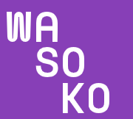


Acknowledgement to Contributors to the Report
START-UPS THAT CONTRIBUTED TO THIS REPORT

Slide 5


















Acknowledgement to Contributors to the Report
GOVERNMENT AGENCIES AND INSTITUTIONAL BODIES
Office of the President,
SME Advisory Unit

Slide 6



















Acknowledgement to Contributors to the Report
INVESTORS AND DONORS

Slide 7
















Acknowledgements to Contributors to the Report
UNIVERSITIES

Slide 8














Acknowledgement to Contributors to the Report
HUBS, INCUBATORS AND ACCELERATORS

Slide 9
Table of Contents
Table of Contents
Executive Summary
Introduction
Startups
Micro Small and Medium Enterprises
Hubs Accelerators and Incubators
Academic Institutions
Government
Policies
Investors

Slide 10
Acronyms
Acronyms
ASSEK | The Association of Startup and SMEs Enablers of Kenya
AVCA | The African Private Equity and Venture Capital Association
BDS | Business Development Services
CBK | The Central Bank of Kenya
COVID-19 | Coronavirus disease caused by the SARS-CoV-2 virus
FCDO | The Foreign, Commonwealth and Development Office
FGD | Focus Group Discussion
GIZ | Deutsche Gesellschaft für Internationale Zusammenarbeit
ICT | information, communications and technology
IPO | Initial public offering or stock launch
KAM | Kenya Association of Manufacturers
KeNIA | Kenya National Innovation Agency
KenInvest | Kenya Investment Authority
KEPSA | Kenya Private Sector Alliance
KIE | Kenya Industrial Estates Ltd
KII | Key Informant Interviews
KIRDI | Kenya Industrial Research and Development Institute
MSEA | Micro and Small Enterprises Authority
MSMEs | Micro, small and medium enterprises
SDGs | Sustainable Development Goal
UN | The United Nations
UON | The University of Nairobi
VC4A | Venture Capital for Africa
WEDF | Women Enterprise Development Fund
YEDF | Youth Enterprise Development Fund

Slide 11
List of Tables
List of Tables

Slide 12
List of Figures
List of Figures

Slide 14
Executive Summary
Executive Summary
The Kenyan startup ecosystem is among the most thriving in the African ecosystem, coming third after Nigeria and South Africa, there has been a general improvement in the total amount of funding raised by startups. African startups raised USD 2.14 billion¹, the bulk of which took place in Nigeria, South Africa, Kenya, and Egypt. Kenya on its own had 87 startups, raising a total of USD 291m. In the first quarter of 2022, the start-up sector attracted USD 401 million in funding. Yearly funding is expected to reach KES 100 billion by 2025².
SUMMARY OF KEY FINDINGS
Majority of startups have concentrated their operations within the county’s capital, Nairobi this is also true for SMEs in the country
The Agricultural sector attracts most of the startups although the largest proportion of investors prefer the healthcare sector
The main challenge faced by startups and SMEs is finding suitable investors. This is also the case for SMEs
Women still make up a smaller percentage of founders of startups and SMEs than male founders.
Startups cite corruption, tax laws, legal procedures and operating costs as their top challenges. The primary barrier to SMEs' operations, according to them, is a lack of investor-friendly legislation.
Over the last ten years, hubs have become more focused in specific sectors like agriculture, healthcare and fintech.
GOVERNMENT AND ACADEMIA
The government's involvement in the startup ecosystem has grown initially from the Science Technology and Innovation Act, which sought to protect innovations, through to the MSME Act for regulation of the MSE sector And on to the more recent startup bill meant to provide a regulatory framework for the operations
of startups . Through other agencies like NACOSTI and KeNIA, the government has tried to regulate the ecosystem. The government's role through the drafting of the startup bill has additionally received mixed reactions from startups and investors. Some investors have pointed out that even though this is a good gesture, there is a need
https://disrupt-africa.com/tag/african-tech-startups-funding-report/

Slide 15

Executive Summary
to review the contents of the bill and to seek more participation from sector players. Start-ups have different reactions to the regulatory framework meant to regulate their businesses. The government could play a wider and more expansive role in its bid to regulate the sector by providing risk-free capital to these startups. Risk-free capital provision would help in addressing the early stage funding problem experienced by startups.
Academic institutions, particularly universities, are key stakeholders in the ecosystem . The role of universities is reflected more accurately through the establishment of incubation hubs. Some of the largest universities in Kenya established these hubs more than 10 years ago. Specifically, Strathmore University developed (iLabAfrica), the University of Nairobi (Nailab and C4DLab), and Kenyatta University (Chandaria Business and Innovation Centre).
INVESTORS
Funding options are mainly provided by either private equity, venture capital, or angel investors. The country has also seen an improvement in its investor ecosystem. With more than 24 private equity firms and over 71 venture capital firms in Kenya¹, investors provide different types of support apart from funding, including technical assistance, business development, and corporate governance. The growth of the ecosystem has seen the rise of venture capital firms like Fanisi Capital, Savannah Fund and AFZA Capital. Most investors in Kenya are sector agnostic and have no sector reference, although a great majority still invest in
particular sectors of the economy. Investors have invested in different rounds in a bid to diversify their portfolios, with some startups like Twiga Foods attracting series C funding. The provision of funds for these startups at different funding rounds is important in providing both short-term and long-term capital to ensure sustainability and survival. As the continent attracts more and more funding, it is vital that startups are investor ready and that necessary regulatory policies are amended to encourage investors' participation.
1. https://data.worldbank.org/indicator/SL.UEM.TOTL.ZS?locations=KE
2. https://disrupt-africa.com/tag/african-tech-startups-funding-report/

Slide 16

Executive Summary
FUNDING
On matters of funding, startups in Kenya generally face an acute funding shortage due to reasons identified by the study, such as lack of investor preparedness, lack of knowledge on how and when to get funds, among others. However, there has been a general improvement in the total amount of funding raised by startups. According to the African Tech Startups Funding Report¹ of 2021, African startups raised USD 2.14 billion, the bulk of which took place in Nigeria, South Africa, Kenya, and Egypt.
Kenya on its own had 87 startups, raising a total of USD 291m. The venture capital ecosystem surpassed capital investment in 2021 despite having 62% fewer deals. In the first quarter of 2022, the start-up sector attracted USD 401 million in venture funding². Funding options are mainly provided by either private equity, venture capital, or angel investors.
https://disrupt-africa.com/tag/african-tech-startups-funding-report/
https://magnitt.com/research/kenya-q1-2022-venture-investment-report-50817

Slide 17








Executive Summary
Market Size
Super Sized Deals
Ranking
Startup market estimated at us$
2 supersized deals worth more than US$100m
Ranked 1st in East Africa and 3rd in Africa. The country ranks 62nd Globally in ease of doing business
SMEs and Startups
KEY
FACTS
1,000 + Startups with over 7.4m MSMEs
PE & VC
More than 24 PE firms and 71 VC firms funding the ecosystem
Hubs, Accelerators
Academia
More than 249 hubs and 50+ accelerators with 1, 160 county innovations set for establishment
Growth Prospects
442% growth in funds raised in H1 2022 compared to H1 2021¹. Yearly funding expected to reach KES 100B by 2025²
https://techcrunch.com/2022/08/09/in-africa-kenyan-startups-have-so-far-recorded-highest-funding-growth-this-year/
https://www.capitalfm.co.ke/business/2022/06/yearly-funding-for-kenyan-start-ups-projected-to-hit-sh100bn-by-2025/

Slide 18
1 | Introduction
1
INTRODUCTION
Research and secondary data show the ever-rising numbers of start-ups, incubators, innovation hubs, and accelerator programs. In Kenya, the sector appears to be booming, with more and more start-ups sprouting across different sectors of the economy. Entrepreneurship in Kenya serves as a source of employment and a major contributor to economic growth. Medium and small medium enterprises contribute nearly 40% of the gross domestic product and constitutes of nearly 98% of all businesses in the country¹. However, there’s still a gap in the quantitative aspects of the start-up ecosystem as there isn’t much reference point to get reliable data on start-ups.
This research, spearheaded by the FCDO, aims to provide both qualitative and quantitative data regarding the evolution of the start-up ecosystem in Kenya. It presents quantitative data meant to provide a baseline for evaluating the different components of the start-up’s ecosystem in Kenya. The Kenyan government has signaled its support for start-ups and MSMEs through programs like the credit guarantee schemes and research funds. Academic institutions like universities have also done their part through the setting up of incubation and innovation hubs. County government support has been witnessed in the form of county innovation funds and innovation weeks such as those in Laikipia, Machakos, and Nairobi
Apart from the government and its entities, privately-owned innovation hubs and incubators like Gearbox are independently supporting entrepreneurs, graduates and offers support to the ecosystem. There are an increasing number of start-up conferences and competitions like the Shelter Tech Innovation Week, Disrupt Africa Live Pitch, and the Glovo Startup Competitions.
In spite of this, Kenya still continues to possess a crippling business environment caused by inflexible regulatory policies. Investors point out a series of factors that have hindered smooth business operations, from tax policies to inadequate policy support from the government and even high valuation and high cost of talent acquisition.
A look at other countries above Kenya, such as Nigeria in South Africa, reveals that favorable government policies and ICT infrastructure go a long way in ensuring growth of the economy. Although Kenya remains top within the East African region and still third in Africa, there are many challenges, especially in the macroeconomic and regulatory environments, that remain unsolved. The dissonance in objectives; increasing entrepreneurship while enforcing tax regulations on new businesses, makes Kenya an intriguing economy for further investigation.
1. https://www.centralbank.go.ke/2021/07/15/2020-survey-report-on-msme-access-to-bank-credit/

Slide 19








STARTUP DEFINITION AND CHARACTERISTICS
Product
Timeline
Earnings and Scalability
Develop a unique product or service, bring it to market and make it irresistible and irreplaceable for customers
Typically between 1-7 years
Targeting a significant revenue, staff and customer growth to establish growing market share and presence
Agile and Lean
Risk
Works quickly to find solutions even though the entire business may not work and has the ability to quickly change to find new solutions to problems faced
Thriving in a high-risk environment, with cashflow often being an issue and hence the need for regular fund raises
Start-up Characteristics
Competition
Disruptive and Unique
Often solves a problem in a different manner than what exists unless the market size if large enough, ability to move beyond geographies in many cases
Looks at solutions that were not previously available in the market and that makes processes easier
Finance
Largely financed by business angels, investors, government programs, venture capitals, venture debt or bootstrapped
Under the proposed start-up bill; a start-up by definition is:
An entity that is registered in Kenya and the ownership is at least one third Kenyan
A newly registered businesses or one that has been in existence for not more that 7 years
An entity involved in innovation development, production and commercialization of innovative products, processes or services
Headquartered or has a branch in Kenya and
A businesses that attributes 15% of its expenses to research and development
Small and growing businesses on the other hand, are commercially viable businesses with 5 – 250 employees that have potential and growth ambition

Slide 20
STARTUP ECOSYSTEM TIMELINE AND KEY NOTABLE EVENTS
2006
2007 - 2008
2010
2011
2012
2013
1st Undersea Internet Cable
Launch of Mpesa
Ushahidi, a crisis mapping app developed
iHub is launched by founder of Ushahidi
iLab, the first University Hub is created in Strathmore
Micro and Small Enterprises Act
Vision 2030 including Konza City as a tech city is launched
Enactment of the STI Act
Launch of Uwezo Fund
Chandaria Innovation Centre, Nailab, C4DN are created
2015
2017
2020
2021
2022
Weze Tele acquired by AFB at $1.7m
Constituency innovation Hubs via the Ministry of ICT plan developed
Amendment of the Finance Act to regulate VC and PE
Draft of the Startup Bill
USD 100M to Ascent PE
$411M raised by startups
USD $50M raised by Twiga
Launch of ASSEK to act as SME enabler
Launch of the ICT Digital Masterplan
KES 1b raised by Solarise
USD $260M raised by Sun King
USD $125M raised by WASOKO
USD $40M raised by Twiga
Academia
Government
Notable Transactions
MKU opens a research hub

Slide 21
1
1.1 RESEARCH PROBLEM
The past decade has seen Africa grow as a potential future tech superpower with a rapidly expanding start-up ecosystem. More accelerators, innovation hubs, and incubation programs are seen across Africa today. The ecosystem is constantly changing and adapting to new trends, and there's a need for existing literature to do the same. Research is critical in ensuring industry participants get the benefits of the ecosystem. It makes it easier for businesses to gauge their market size and potential trade. Research makes impacts quantifiable as governments also depend on data gathered to make impactful decisions.
The Kenyan ecosystem for start-ups suffers from research deficiency as there’s lack of precise high-quality data on the changes and nature of the Kenyan start-up’s ecosystem. It is these facts that this research leverages on as it seeks to bring out clearly the nature of the ecosystem by analysing the evolution of the start-up sector of the Kenyan economy in the past 10 years. This research focuses on changes that have taken place in the ecosystem in the past 10 years as with regards to start-ups, investors, academic institutions and the government. This research also sought to identify key gaps and challenges in the ecosystem and proposes some recommendations change the state of the ecosystem. among the factors considered were contribution of start-ups to the economy of Kenya, the government's role in encouraging Innovation culture and the role of sectors like academic institutions and investors in developing the ecosystem.
1.2 OBJECTIVES
Main: Outline the evolution of the Kenyan Startup ecosystem for the last 10 years.
Other Objectives:
To trace the development of the Kenyan start-up ecosystem in the past 10 years by considering aspects such as gender, sector distribution and service offering.
Investigate the role of each participant in the development of the Kenya start-up sector by first tracing it's evolution and the changes that have occurred in these sectors including how they are presently adapted in supporting start-ups.
To elucidate and decipher gathered data by presenting it in a form capable of supporting decision making both for government and other participants in the sector.
Highlight areas in which government falls short in its role and recommend solutions in terms of policy and regulatory frameworks under which the ecosystem will flourish and such policies in which the entire sector is Pareto optimal.
1.3 SCOPE
This Study was conducted in Kenya across all the 47 counties.
1. https://cytonn.com/uploads/downloads/ease-of-doing-business-note.pdf

Slide 22
1
1.4 METHODOLOGY
This study provides an overview of the Kenyan ecosystem, specifically focusing on the evolution of ecosystem participants, gaps and challenges, both regulatory and otherwise, as well as recommendations for solving the gaps identified. The research utilizes both primary and secondary data. Primary data was obtained from sources like online surveys (Google forms), structured face-to-face interviews, and phone follow-ups. Secondary data was obtained from the Kenya National Bureau of Statistics (KNBS) Survey 2016, Central Bank Survey Report 2020, World Bank Doing Business Report 2020, Crunchbase, Venture Capital for Africa, and other publications on the startup sector in Kenya. Case studies for uniquely selected enterprises were also used.
It is worth noting that the population of start-ups surveyed was assembled based on consultations with active members of the ecosystem to identify early-stage start-ups with a focus on those who have been in the market for the last 10 years, those who have raised capital, and those who have female founders. This research also included a detailed evolution analysis of all participants in the ecosystem, including SMEs. The study was carried out by a diverse collaboration with other academic institutions. In order to better understand the ecosystem, our survey sought to obtain the following information regarding startups: year of founding of the startups; annual revenue generation; service offering; location of operation; number of employees; gender composition of employees; stage in the business life cycle; amount of funding raised; major constraints in raising finance; type of funding raised and future prospects of raising funding. Although there are limitations to this work, it is hoped that it will allow other actors to evaluate progress and identify possible intervention mechanisms to support the growth and development of the startup ecosystem.
1.5 SAMPLING
The study adopted a random sampling technique in which each sample has an equal probability of selection provided it meets the criteria for a startup definition. Participants in this study were, investors, startups, government agencies, academic institutions, innovation hubs and incubator programs. The table that follows summarizes the list of participants along with the method for data collection used.
Category | Survey Sample | Data Collection technique
Startups | 36 | Physical, zoom and video interviews, online surveys
SMEs | 64 | Physical and zoom interviews, online survey
Public Sector Players | 12 | Physical, zoom and video interviews, online surveys
Accelerator and Hubs | 14 | Physical, zoom and video interviews, online surveys
Academic Institutions | 19 | Physical and zoom interviews, online survey
Investors and Donors | 19 | Physical, zoom and video interviews, online surveys
Tech and smart cities | 1 | Physical interview

Slide 23

2
STARTUPS

Slide 24
2 | Startups
2
STARTUPS
The Kenyan Startup Ecosystem, though a young segment, ranks first in East Africa, 3rd in Africa (after Nigeria and South Africa) and 62nd globally. The ecosystem presently is a leading hub for entrepreneurs in Africa due to aspects like a growing number of engaged investors internationally, a huge population with technology access, and a growing number of support organizations in the ecosystem. The growth, however, of the Kenyan startup ecosystem can be traced back to 2006 when the undersea Internet cable was laid down. This resulted in a boom in connectivity and kickstarted the formation of some of the earliest startups.
In the 20th, there was a drop in the price of mobile phones, which saw Kenya's usage of mobile phones and the internet grow. This saw the creation of Mpesa, later taken up by Safaricom. iHub, Kenya’s first tech hub, was created in 2008 by Erick Hersman after he founded Ushahidi. iHub would later become Africa’s pioneering co-working and incubator space. iHub created an environment that allowed startups, especially in the tech field, to grow and sprout.
With startup scene mushrooming, the Kenyan government took note and started supporting the ecosystem. The government went ahead to approve the construction of the first tech city in Africa in 2008 (Konza City). The more recent Startup Bill by the government is meant to provide a regulatory framework for the operation of startups. The city was meant to bolster innovative minds and facilitate employment.
Kenya now has over 1000¹ startups in various sectors such as agriculture, education, clean energy, and the environment, to name a few. Among the big startups in Kenya are Jumia, an online retailer offering different categories of products; Twiga Foods, an online platform offering farm products; and Apollo Agriculture, which offers loans to farmers.
Although it may appear as if the Ecosystem is thriving, different sector players have raised different issues regarding the challenges and gaps that still exist in the ecosystem. Investors cite unfriendly policies even though the country ranks 70th in the world in terms of ease of doing business. The Kenyan startup ecosystem is showing promising prospects with funding expected to hit KES 100B yearly³.
https://tracxn.com/explore/Startups-in-Kenya
https://techcrunch.com/2022/08/09/in-africa-kenyan-startups-have-so-far-recorded-highest-funding-growth-this-year/
https://www.theeastafrican.co.ke/tea/business/african-technology-startups-3807064

Slide 25
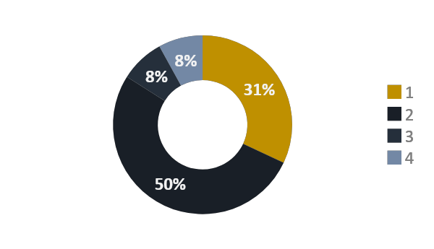
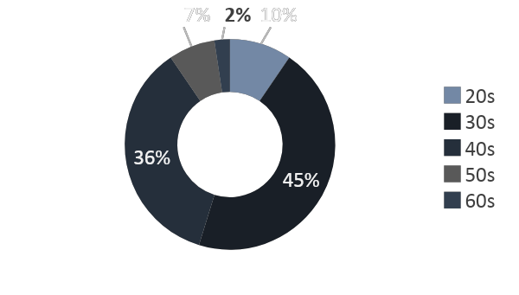
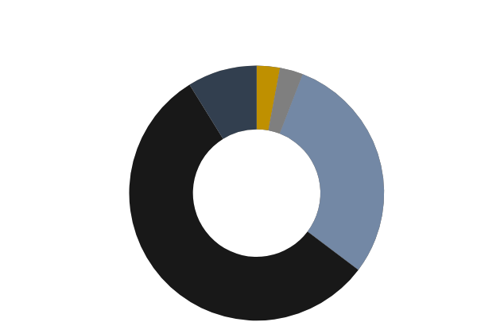
Startups
2
1.1
SURVEY FINDINGS
1.1.1 FOUNDER ANALYSIS
An analysis of 26 startups in the Kenyan ecosystem reveals that a greater majority (50%) have exactly two founders, 31% have one founder, 8% have three founders, startups with four founders are 8% of the proportions, and 4% have more than five founders. In terms of founder ages, the largest majority of startups (45%) were founded by founders in their 30s, followed by 36% founded by founders in their 40s. Founders in their 50s and 60s founded 7% and 2% of all startups in the survey.
Fig x: Number of founders
Fig x: Age of founders
Fig x: Year of Founding
56%
Of startups were founded between 2015-2020
6%
Of startups were founded between 2000 - 2004
56%
2015-2020
9%
2021-2022
3%
2000-2004
29%
2010-2014
3%
2005-2009
1.1.2 FEMALE PARTICIPATION
There exists a disparity between male and female participation. 55% of startups had no female founders. Results on the number of employees show that 27% of startups have between 11 and 20 employees or 21 and 50. Only 6% have between 50-100 employees. When assessed on number of female employees, 35% of startups reported that 41%-60% of their employees were females. The same proportion (35%) was reported for startups having 21%-40% and 41%-60% of employees being female.

Slide 26
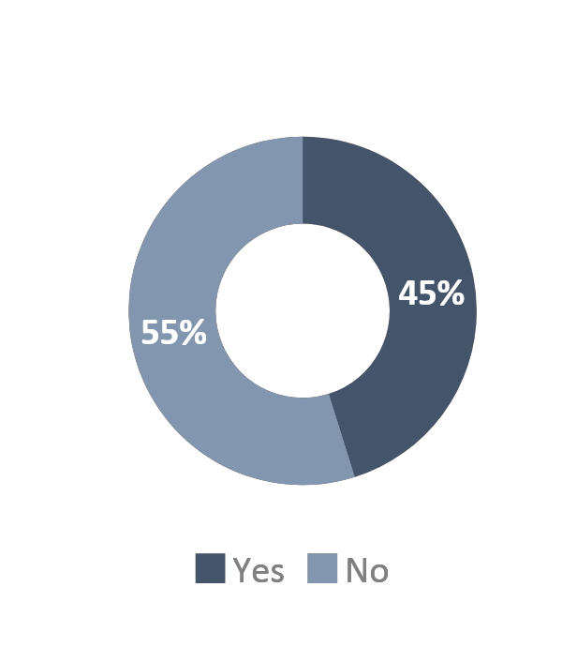
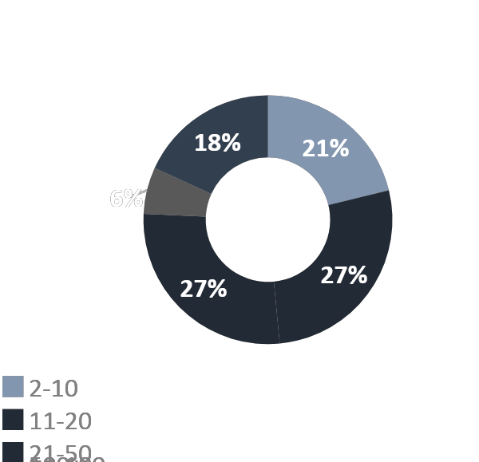
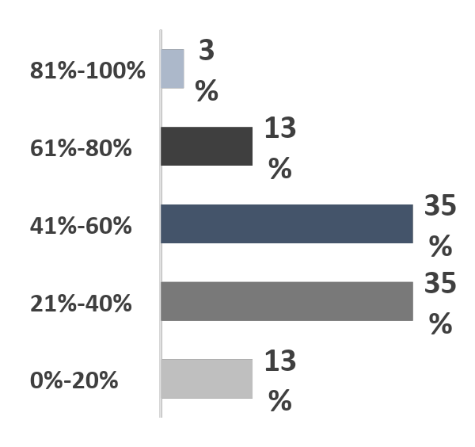
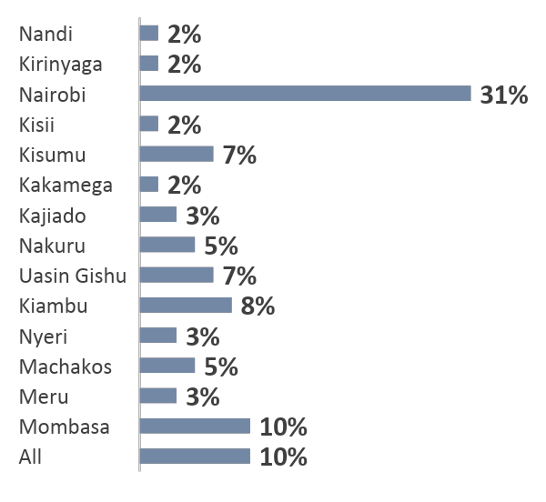
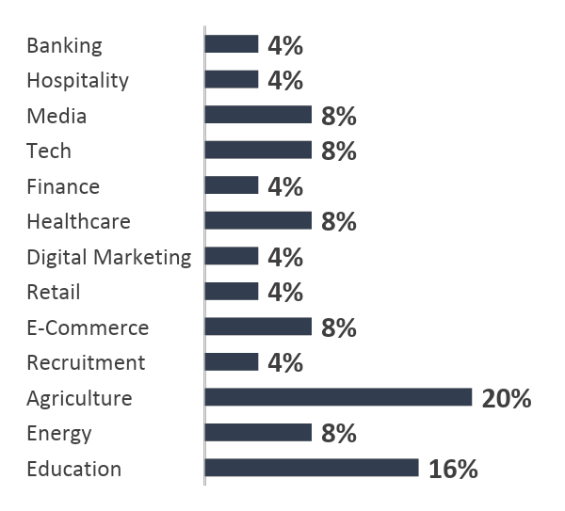
Startups
2
Fig X: Female founders
Fig x: No of employees
Fig X: Female Employees
1.1.3 GEOGRAPHIC AND SECTOR DISTRIBUTION
Startups in the country operate across different sectors in the economy offering different services. A sector breakdown is presented across 13 sectors. The most popular sector is agriculture followed by education. Countywide distribution reveals that 31% of startups operate within Nairobi.
Mombasa comes second (10%). It is worth noting that Nairobi and Mombasa are the only two cities ranked by the StartupBlink Report. Nairobi is 163rd globally while Mombasa is 891st . Nationally, Nairobi is ranked first while Mombasa comes second. This could be an explanation for startups preferring to operate mainly within the city¹.
Fig X: County-wise distribution of startups
Fig X : Sector distribution of startups
31% of startups operate within the country’s capital (Nairobi)
20% of startups are in the agricultural sector
2
https://www.startupblink.com/startup-ecosystem/kenya

Slide 27
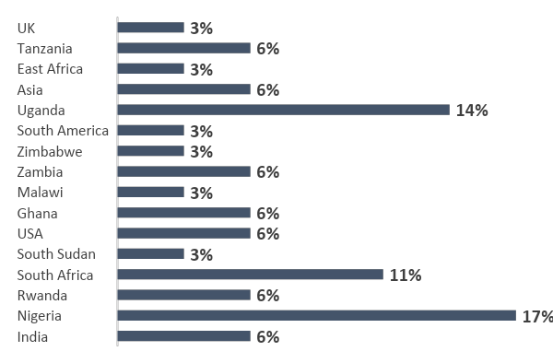
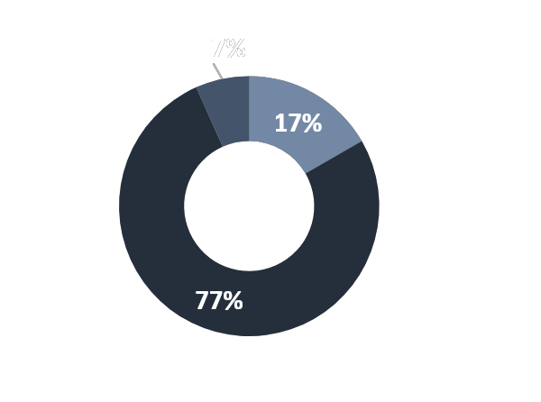
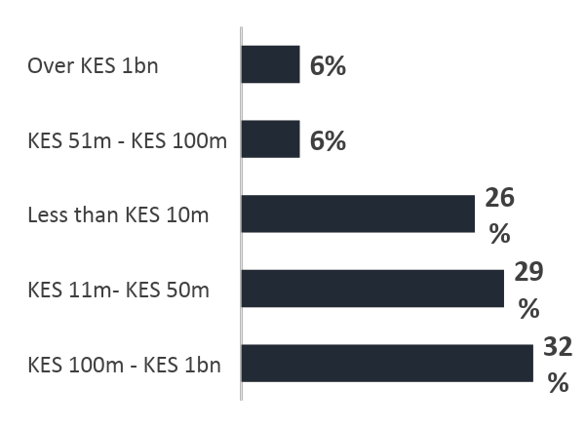
2 | Startups
The StartupBlink Ecosystem Index Report of 2021 reported South Africa to have the most developed startups ecosystem Africa¹. Kenya was ranked second with Nigeria coming third. Startups business operation outside of Kenya analysis shows that startups operating in Kenya have other operation in Nigeria (17%), South Africa (11%) and Uganda (14%).
Fig x: Outside operation of startups
17%
of startups operating in Kenya also operate in Nigeria
UGANDA
Is the second top operation center for startups in Kenya after Nigeria
1.1.4 STARTUP FUNDING
This section analyses the funding scenario based on responses from participants of the study. Business lifecycle analysis (early stage, growth and expansion and Maturity and Possible exit) shows that 77% of startups are in the growth and expansion stage while only 7% of startups have reached maturity and possible exit. Annual revenue analysis shows that the largest majority of startups (32%) earn revenues of between KES 100m-1bn annually with only 6% surpassing the KES 1bn mark.
Fig X: Stage in business lifecycle
Fig X: Annual startup revenue
Growth and Expansion
Maturity and Possible Exit
Early Stage
3
https://lp.startupblink.com/report/

Slide 28
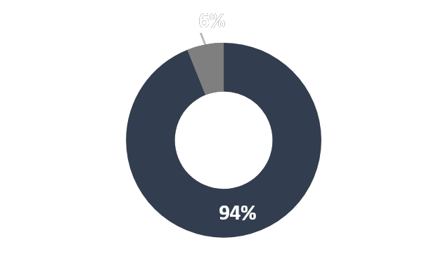
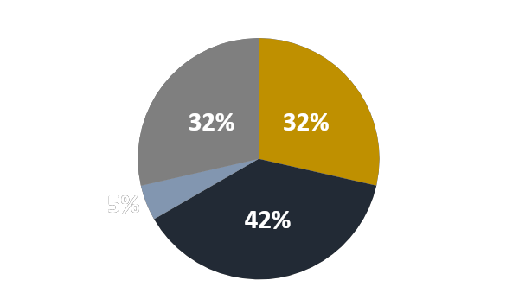
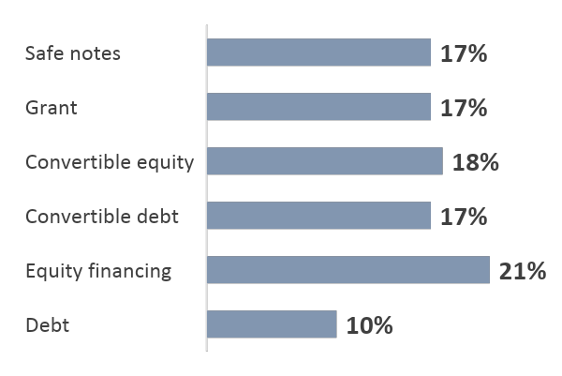
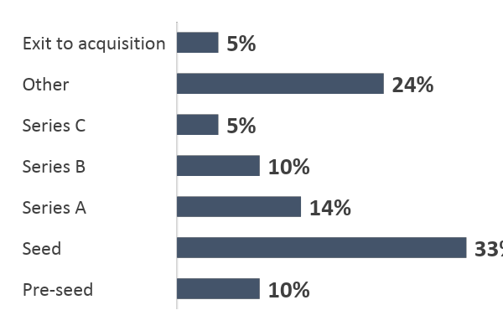
2 | Startups
For raised funding, 42%, the majority, have raised between 101m-500m KES, 32% have raised 10m-100m and over 1bn while the least proportion, 5% have raised between 500m-1bn. From the startups that participated, 94% have tried raising funds while 6% have made no attempt. The most common funding type is equity (21%) followed by convertible equity (18%), grant, safe notes and convertible debt all have 17%
while debt is 10%. 21% have raised equity finance followed by 18% who have raised convertible equity, 17% have raised safe notes, grants, and convertible debt finance. Seed funding is the most common type of funding raised by participants in the survey (33%). The least type of financing raised by startups is is series C and exit to acquisition (5%).
Fig x: Attempt to raise finance
Fig x: Amount of funding raised
Over 1b
10m -100m
Yes
No
500m – 1b
101m -500m
Fig X: Type of finance raised
Fig x: Last Funding rounds
Startups appear to have a big difficulty in raising finance. Results from the survey show that 97% have found the process difficult while only 3% say the process is easy. Despite the challenges, 57% seek to raise funding in the next 12 months, 19% after a year, and 10% aren’t seeking to raise funding. From those raising finance, 67% are seeking equity financing, 15% debt and equity, and 11% pure debt, while 4% are seeking grants and safe notes.
4
1.

Slide 29
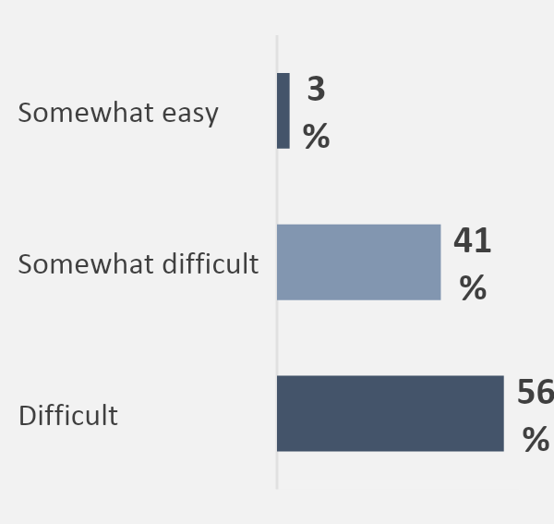
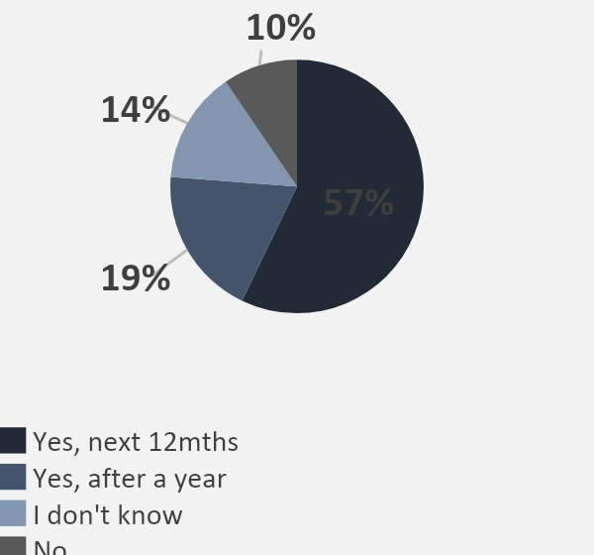
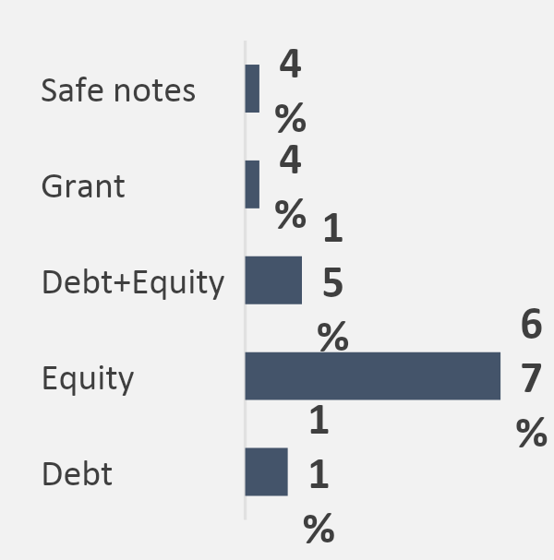
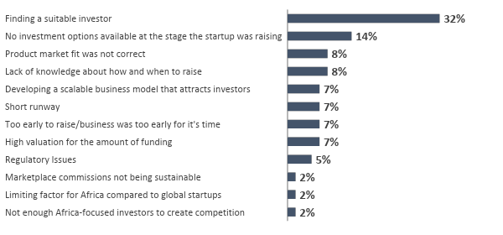
2 | Startups
Fig X: Experience of raising finance
Fig X: Plan on raising finance
Fig X: Type of finance to be raised
Table X: Challenges faced in raising finance.
1.1.5 CHALLENGES FACED BY STARTUPS
32% of startups considered finding suitable investment after 12 months as the main challenge in raising funds. Another 14% said that lack of investment options at the time of raising funds was the main problem.
Fig X: Challenges in raising Finance
Finding a suitable investor is the main challenge facing startups
The table that follows summarizes the level of difficulty that factors are considered to be in the ecosystem. These factors represent a wide array pf issues from aspects of corruption, to tax administration and to digital payment mechanisms. Top of the list is corruption(85%) and tax rates (82%). This creates the need for tax regulations and policies amendment and harmonization to create an enabling environment
5
1.

Slide 30
2 | Startups
Table X: Challenges faced by startups in the ecosystem .
Factor | Obstacle | No obstacle
Corruption | 85% | 15%
Tax rates | 82% | 18%
Legal processes and costs of running a business | 80% | 20%
Availability of market information | 80% | 20%
Tax administrations | 77% | 23%
Tax administrations | 75% | 25%
Legal processes and costs of setting up a business | 75% | 25%
Investor friendly legislation | 75% | 25%
Practices of informal sector competitors | 75% | 25%
Laws and processes for foreign investment in start-ups | 70% | 30%
Labour Regulations | 67% | 33%
R&D initiatives and University collaborations | 45% | 55%
Digital payment mechanisms | 35% | 65%
From the table , among the top challenges faced by startups in the county (corruption, tax rates, legal processes) are policy related issues. There lies a gap therefore in policy formulation to improve on areas such as tax administrations and investor friendly regulations
1.1.6 OTHER FINDINGS
Local and international services offered in the ecosystem to startups are consumed at a different rate. Opinions on whether startups take full advantage of these services offered differ. There seems to be a gap in the local ecosystem supporting the local start-ups, as 55% disagree with the proposition that the ecosystem supports current needs. It is understandable that local startups consume more international services than local services since the majority of funding comes from international investors.
Table X: Opinion poll on local startups taking advantage of local and international services and local ecosystem meeting needs of local startups
Opinion | Strongly Disagree | Disagree | Neutral | Agree
Start-ups take full advantage of services offered locally in the ecosystem | 5% | 50% | 41% | 36%
Start-ups take full advantage of services offered internationally in the ecosystem | 9% | 36% | 55% | 32%
Local start-up ecosystem meets current needs of local start-ups | 18% | 55% | 41% | 18%
6

Slide 31
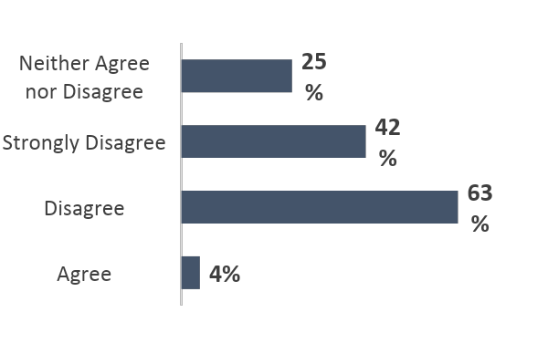
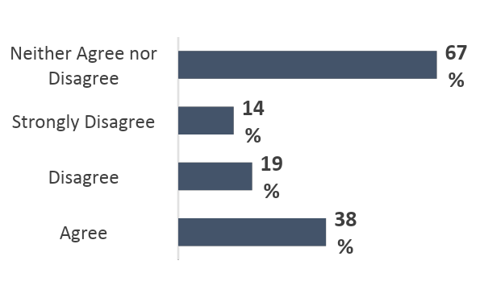

2 | Startups
1.1.7 GOVERNMENT SUPPORT AND THE STARTUP BILL
The startup bill introduced by the Nairobi Senator a year ago was meant to provide a framework to encourage entrepreneurship in Kenya¹. The government additionally through bodies like KeNIA have tried to offer their help in establishing the startups sector. From the survey, startups still feel the need that government should be more involved in supporting the ecosystem. 63% disagree that the government sufficiently supports the ecosystem. The startup Act on the other hand presents indifferent feelings among founders as 67% neither agree nor disagree.
Fig x: Is there sufficient government support for startups
Fig x: Will the Startup Bill Address the challenges
KEY
TAKEAWAYS
The Kenyan Startup Ecosystem has undergone rapid changes in the past decade, from just a few innovation spaces to over 1000 startups currently. The Kenyan government has played a role in ensuring an enabling environment for innovations is created.
The predominant sector for startups in Kenya is Agriculture whereas the top international destination for Kenyan startups is Nigeria then Uganda.
Despite more and more funding coming into the scenarios, startups site finding a suitable investor as the main problem when raising finance. Policy regulated issues have also been raised as a hinderance to raising finance.
7
1. https://iclg.com/briefing/16986-new-startup-bill-will-foster-entrepreneurship-but-there-are-still-some-stumbling-blocks-kenya

Slide 32


2 | Startups
1.2
GAPS, CHALLENGES AND RECOMMENDATION
.
GAPS AND CHALLENGES
Lack of seed and angel capital as most startups find it difficult to raise growth capital to kick start their businesses
Lack of linkages in the ecosystem as the ecosystem remains fragmented and access to information is difficult despite the increasing number of services offered.
Lack of inclusion of startup ecosystem players in policy formulation and high business quality support. There isn't much support that startups get in terms of advice on issues like accounting service, legal advisory and business associations.
Lack of long-term growth capital. PE investors put a high return expectation on invested capital that most startups cannot meet. On the supply side, there is lack of customized products, inflexible collateral definition and high interest rates on loans. On the demand side, startups lack awareness about products and struggle with investment ready models for investors.
RECOMMENDATIONS
Make information regarding startups more accessible. This could be done through tech-enabled information platforms, and portals
Strengthen collaborations between actors in the ecosystem through media platforms , business networks and industry gatherings to help train young business founders.
Unlocking angel investment form local high net-worth individuals and the diaspora by addressing the framework conditions for investing. This can be done through policy advocacy on double taxation and restrictive repatriation laws.
Investing in women and more diverse teams to enable representation of women as both founders and fund managers.
8

Slide 33

3
MICRO,
SMALL AND MEDIUM ENTREPRISES

Slide 34
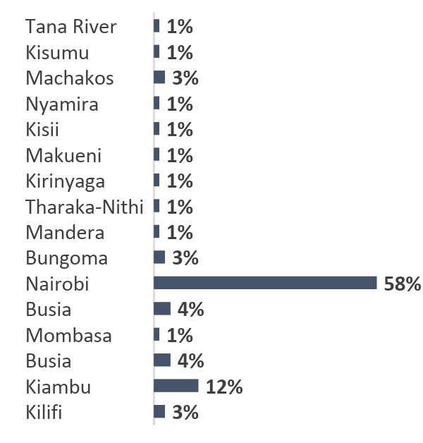
3 | SMEs
3
MSME ECOSYSTEM
SME accounts for 90% of all business and more than 50% of employment¹. Metrics used in defining SMEs according the MSME Act are number of employees, capital and turnover. According to KIPPRA, an SME has between 1 to 99 employees where, micro have less than 10 employees, small enterprises have 10 to 49 employees while medium enterprises have 50 to 99 employees². Kenya has over 7.4 million MSMEs employing approximately 14.9 million Kenyans in different sectors of the economy. Of the 7.4 million, only 1.56 million are licensed to operate³. The SMEs are distributed in different parts of the country with a majority headquartered in Nairobi.
The journey towards SME sector revitalization can be traced to the Kenya Local Government Reform Program (KLGRP) of 1999 which sought to come up with relevant policies for poverty reduction. The KLGRP had three main components; enhancing economic governance, improving local service delivery and poverty alleviation⁴.
The government initiated to nationwide reforms efforts; Single business Permit and Local Authority Transfer Fund. SBP was meant solve the licensing problems faced by SMEs in the startup phase. Part from government, there has also been international support towards the growth of SMEs. The IFC and CBK worked together to establish the CRB which enable non-land assets to be acceptable as collateral. The government also set up the revolving fund to improve financial service access to SMEs. More Recently, KEPSA received 2.2million from the NSE to support SMEs⁴.
The government also initiated the SME Act in 2012 to help regulate the SME. KEPSA, in partnership with the Corporate Council on Africa, aims to help MSMEs access wider markets. Further, KEPSA established an annual supplier diversity summit which seeks to sensitize, influence organizations to adopt gender-inclusive supply chains and link women/youth-led/owned SMES to emerging opportunities. Additionally, in a bid to expand and improve the SME sector, the government launched the Kenya Industrial Transformation Program (KITP) under the Ministry of Industry, Trade and Cooperatives in 2015.
Fig X: SME Distribution
1
https://www.worldbank.org/en/topic/smefinance
https://kippra.or.ke/characteristics-of-kenyan-msmes-relevant-to-the-proposed-kenya-credit-guarantee-scheme
https://www.kenpro.org/papers/sme-policy-in-kenya.htm
https://kepsa.or.ke/

Slide 35
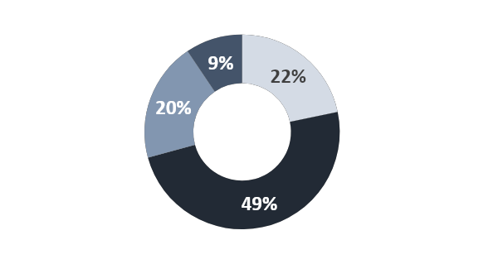



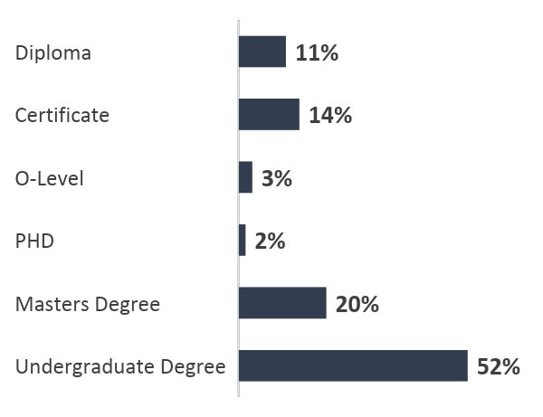
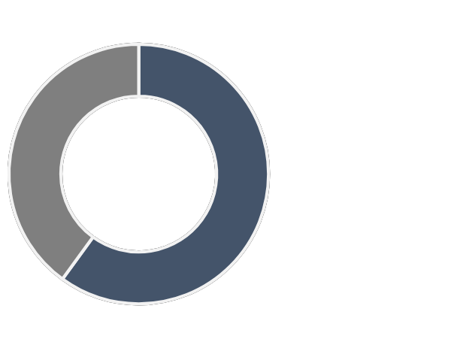
3 | SMEs
3.1
SURVEY FINDINGS
3.1.1 FOUNDER AND OWNERSHIP ANALYSIS
An analysis into the ownership characteristics of SMEs in Kenya as per the survey conducted shows that majority of SMEs(51%) have one founder, 27% have two founders while 24% have three founders. From a sample of 106 SMEs 49% of founders are in the 30s, 22% are in their 20s while 20% and 9% are in their 40s and 50s respectively.
Undergraduate degree holders form a majority proportion of total founders as 52% of 66 SMEs have undergraduate degree holders as founders. 20% of founders have a masters, degree, 2% are PHD holders, 3% are o-level holders, 14% are certificate and 11% diploma holders. Out of 95 SME founders, 60% have founded other businesses while 40% haven’t
Fig X: Number of Founders
Fig X: Age of founders
50%
has one founder
27%
has two founders
In their 40s
49%
are in their 30s
in their 50s
23%
has three founders
In their 20s
Fig X: Founder Highest level of education
Fig X: Have the Founders founded any other businesses
40%
No
60%
Yes
2
https://statistics.knbs.or.ke/nada/index.php/catalog/69

Slide 36
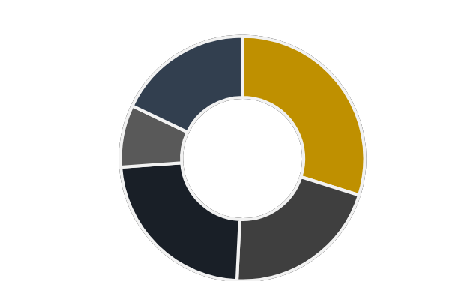
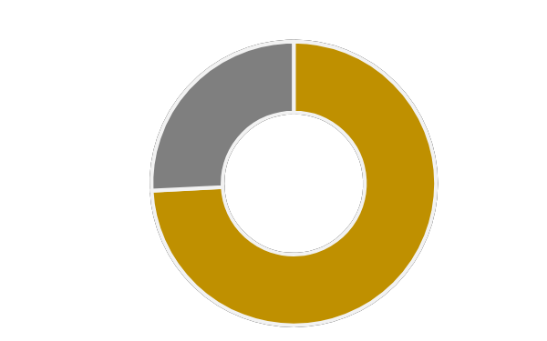
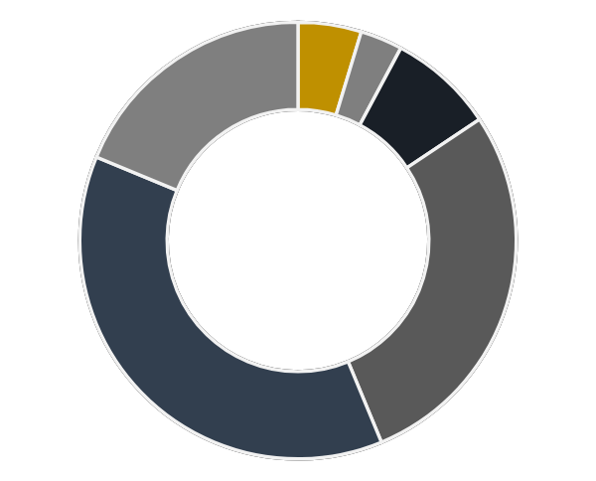
3 | SMEs
This survey shows that most founders own less than 20% of their businesses (40 out of 134 SMEs founders). Only 8% own between 60% - 80% of their businesses. The experience of a business founder is a key factor in the success of any business. SMEs in the survey were also assessed on previous experience of founder. The survey shows that 74% of SME founders have previous experience in running a business while 26% have no previous experience.
This survey also highlights the age of SMEs. From 64 respondents, 39% of SMEs were founded between 2016 – 2020. This is the largest proportion for SMEs. Only 5% of SMEs were founded before 2000. More results on these aspects are presented in the graphs that follow
Fig X: % of ownership of founder
Fig X: Does the founder have previous experience running a business
18%
81% - 100%
30%
<= 20%
8%
61% - 80%
26%
No
18%
41% - 60%
21%
21% - 40%
74%
Yes
Fig X: Founding Year of SME
38%
2016-2020
19%
2021-2022
Founding Year
5%
Before 2000
3%
2000-2005
28%
2011 - 2015
8%
2006-2010
2
https://statistics.knbs.or.ke/nada/index.php/catalog/69

Slide 37
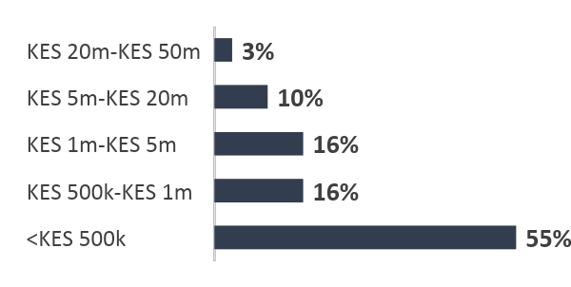
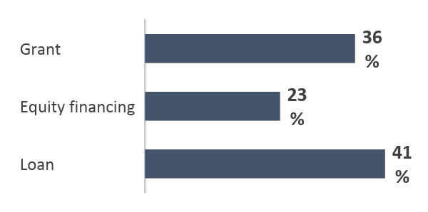
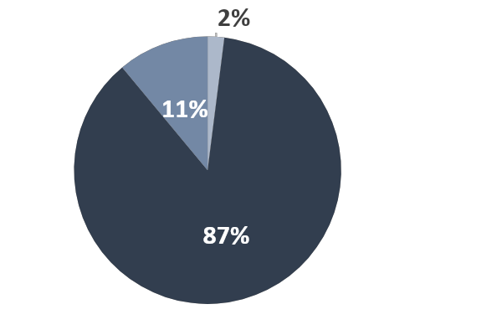
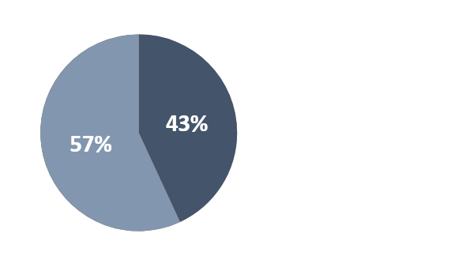
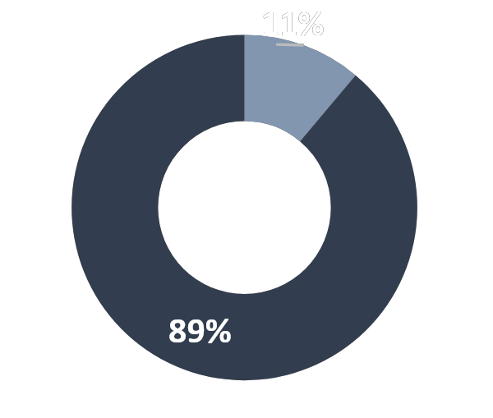
3 | SMEs
3.1.2 SMES AND FINANCING
Majority of Kenyan SMEs trying to raise funds have raised amounts less than 500K with a very small proportion hitting the 20 million funding mark. The most common type of funding is loan funding as 41% have raised loan funding
Fig X: Total amount of funding raised to date
Fig X:Type of funding raised
only 3% of SMEs have raised more than 20M
Only 36% have received grant funding.
87% described the process of rating finance as difficult while only 2% found the process easy. No SME finds the process of raising follow on finance easy. This is inline with the survey’s finding that only 11% of SMEs have raised follow on finance (Series A, Series B, and Series C) where as (89%) have not raised follow-on finance.
Fig x: Process rating of raising initial finance
Fig x: Process rating of raising follow-on finance
43%
Rate the process of raising follow on finance as difficult. 57% don’t know
Don’t know
Fig x: Raising follow-on finance
89%
haven’t raised follow-on finance. Only 11% have
87%
find the process of raising finance difficult
2%
find the process easy
3

Slide 38
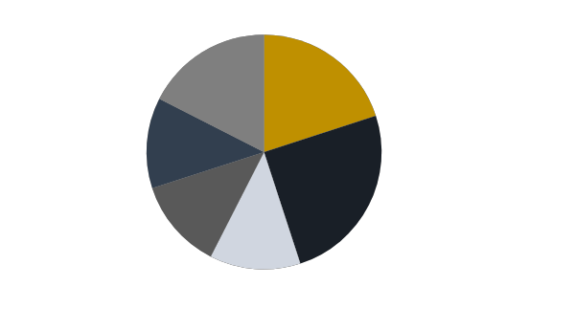
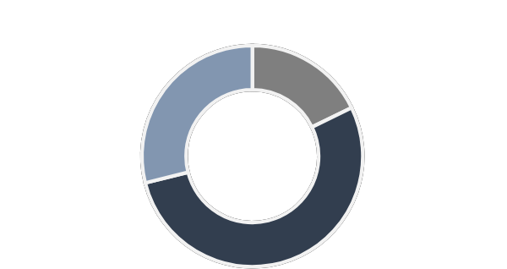
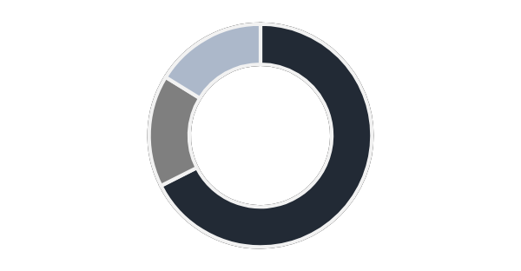
3 | SMEs
SMEs find the process of raising funds difficult, with 25% of SMEs citing the problem of finding suitable investors as the main challenge in raising funds. 20% see developing a scalable business model that attracts investors as the main challenge. 13% of SMEs find the determination of the amount to ask for as the main hindrance to raising finance, while the remaining 18% attribute difficulties in raising finance to a lack of knowledge about how and when to raise finance.
Fig x: Challenges faced in raising finance
18%
Lack of knowledge about how and when to raise
20%
Developing a scalable model
to attract investors
13%
Determining how much money to ask for
13%
No investment options available at the stage of raising
25%
Finding a suitable investor
13%
Regulatory Issues
Despite the difficulty in raising finance, 53% of SMEs are planning to raise finance within the next 12 months while 18% plan to do it after 12 months.
29% however, does not plan on raising any finance. Additionally, equity in the most sough after type of financing(68%) followed by debt and quasi-equity (16%).
Fig X: Plan on raising finance
Fig X: Type of finance sought
53%
Don’t intend to raise
29%
Will raise in next 12m
16% Quasi-Equity
16% Debt
18%
Plan to raise after a year
62% Equity

Slide 39
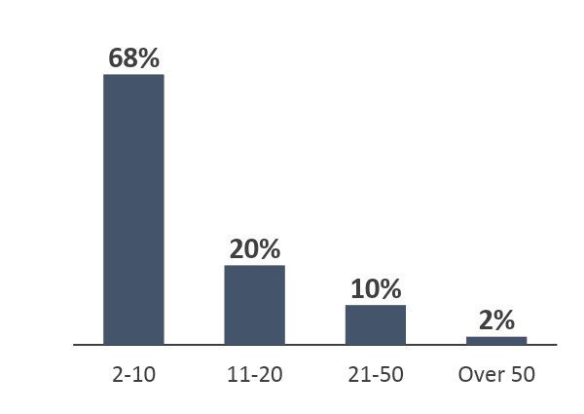
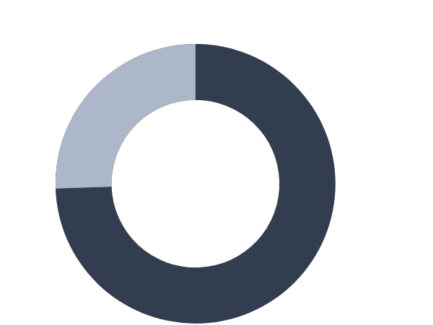
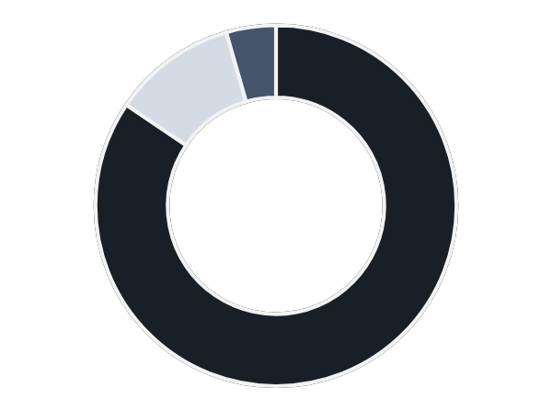
3 | SMEs
3.2.3 SME AND EMPLOYMENT
Kenya has over 7.4 million MSMEs employing approximately 14.9 million Kenyans in different sectors of the economy¹.
According to Micro and Small Enterprises Authority (MSEA), the MSME sector created approximately 14.5 million jobs in 2021². Given that the SME sector is instrumental in job creation, the survey sought to investigate the number of jobs that have been created by the SMEs who participated in the survey. 74% of SMEs agree that jobs have been created in the last 10 years while 24% think otherwise.
Number of employees working in SMEs
68%
Have 2-10 employees
Opinion on whether new jobs have been created in the last 10 year
Fig X: Number of employees
26% disagree
74%
agree that jobs have been created in the last 10years
11%
11-20
4%
Over 20
84%
2-10
Fig X: Any new jobs created in last 10 years?
Fig X: How many jobs has your business created in the last 10 years
Of the 50 SMEs sampled, 34 (68%) have between 2 to 10 employee, 10 (20%) have between 11 to 20 employees, 5 (10%) have between 21 to 50 and only 1 (2%) has more than 50. This implies that majority of the SME, though creating employment, only do so in a limited capacity. This is reflected in number of jobs created over past 10 years
4

Slide 40
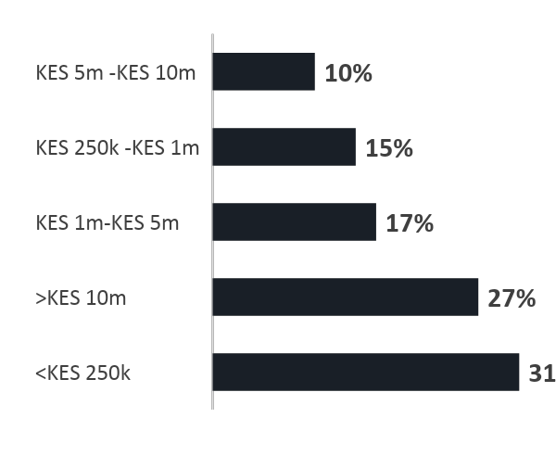
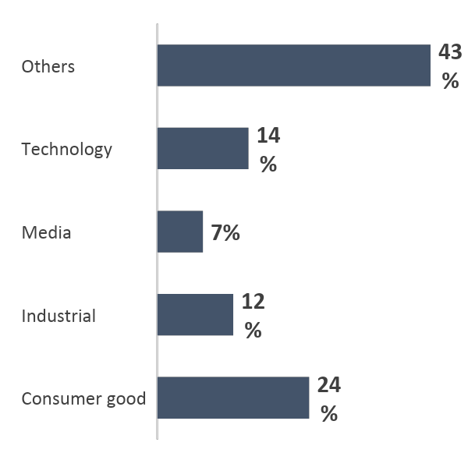
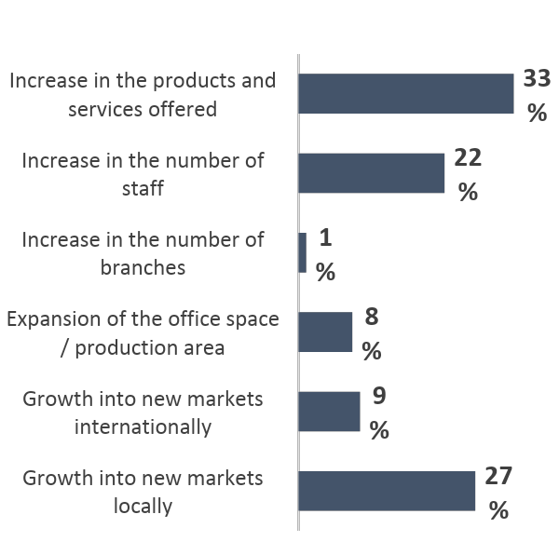
3.2.4 OTHER FINDINGS (SECTOR, GROWTH, REVENUE, LIFECYLE)
Kenyan SMEs fall under a wide array of sectors, this survey grouped sectors into 5 ( Consumer goods, Industrial, Media, Technology and Others). 24% of SME (from 42 respondents) operate e under the Consumer goods sector. Only 7% are in the Media sector . The largest majority are in other sectors apart from the ones mentioned.
Fig X: Revenue earned so far
Fig X: Which sector does your startups fall under
SMEs cite different growth aspects experienced in the last 10 year from growth into new markets locally and internationally, to expansion of office space and increasing number of branches among others. The most aspect of growth was increase in products and services offered while the least was increase in number of branches
Fig X: Aspects of growth experienced in past 10 years
Revenue analysis of SMEs reveals that the largest percentage(31%) of SMEs have made less than KES 250,000 since they were founded. 27% have made it past the KES 10m revenue, 10% have made between KES 5m – 10m. The remaining 17% have made between KES 1 – 5m. These findings are from 48 responding SMEs. On grounds of business life cycle, most SMEs are in the growth and expansion stage (36%) with only 7% being in the maturity and possible exit stage. 16% are in the development and launch stage while the remaining 36% are in early stage.

Slide 41
3 | SMEs
3.2.4 CHALLENGES
Other than funding and access to finance, the survey also sought to find out how other factors affected the operations of SMEs in the country. Investor-friendly legislation, corruption, tax rates, tax administrations, legal process, labor regulations, and digital payment mechanisms were also considered. Of these challenges, those that scored highly among SMEs (those considered to be major obstacles) were investor-friendly legislation (97%), corruption (97%), tax rates (92%) and Legal processes and costs of setting up a business (94%)
The top four factors considered obstacles in operations of SMEs are mainly policy related. This shows the urgency with which the government needs to implement policies to guard against these aspects. These percentages represent the degree to which these factors are considered an obstacle in the operation of the SME ecosystem. The lowest ranked obstacle was digital payment mechanisms, where 59% considered this an obstacle while 41% felt otherwise. The results of these factors have been tabulated in the table that follows in descending order.
Table X: Degree to which elements of the policy and business environment are an obstacle to current operations of SME
Factor | Obstacle | No obstacle
Investor friendly legislation | 97% | 3%
Corruption | 97% | 3%
Legal processes and costs of setting up a business | 94% | 6%
Tax rates | 92% | 8%
Legal processes and costs of setting up a business | 91% | 9%
Tax administrations | 91% | 9%
Practices of informal sector competitors | 91% | 9%
Laws and processes for foreign investment in start-ups | 87% | 13%
Availability of market information | 83% | 17%
Labour regulations | 81% | 19%
R&D initiatives and University collaborations | 76% | 24%
Digital payment mechanisms | 59% | 41%
From the table it can be deduced that among the top challenges faced by SME operation in the county (Investor friendly legislation, legal processes and tax rates) are policy related issues. There lies a gap therefore in policy formulation to improve on areas such as tax administrations and investor friendly regulations
5
https://kippra.or.ke/characteristics-of-kenyan-msmes-relevant-to-the-proposed-kenya-credit-guarantee-scheme
https://msea.go.ke/

Slide 42
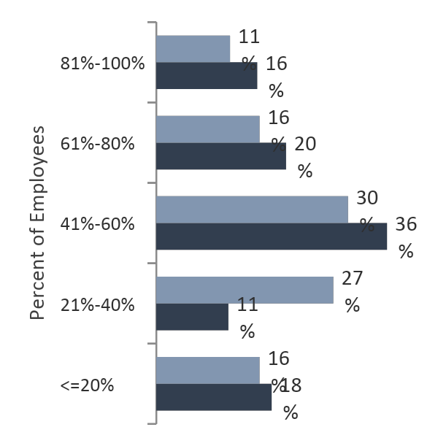
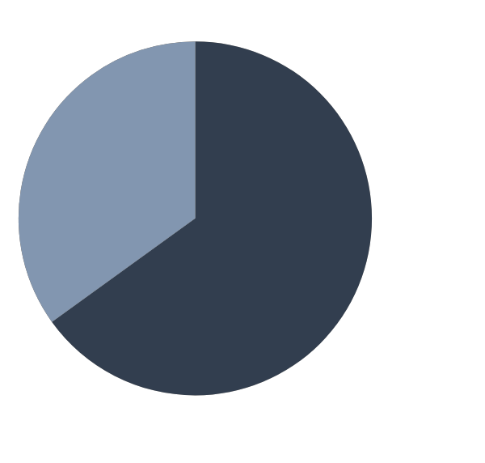


3 | SMEs
3.2.5 SME – THE GENDER LENS
The distribution of MSE by gender is an important factor. According to the MSME Survey report of 2016, 47.9% of licensed businesses were owned by men, while the remaining 31.4% were owned by women. Jointly owned MSME's made up 2.7% of the total. Further, of all unlicensed SMEs, 60.7% are wholly owned by women. The Gender Gap Report 2021 ranks Kenya 95th out of 156 in terms of the gender gap. Quantitative data gathered is in consensus with these figures.
Out of the 83 respondents, 54 (66%) had male founders, while only 29 (35%) had female founders. According to the world Bank statistics of 2021, female form 49.2% of the total labor force¹. A comparison between male and female employees of SMEs from a sample of 45 participants is presented. 36% of SMES report that 41-60% of there employees are female while 30% report that 41-60% are male
Fig x: Male vs Female Founders
Fig x: Male vs Female Employees
35%
65%
There are more male founders than female
6
1. https://data.worldbank.org/indicator/SL.TLF.TOTL.FE.ZS?locations=KE

Slide 43
3 | SMEs
3.2
GAPS, CHALLENGES AND RECOMMENDATIONS
GAPS AND CHALLENGES
RECOMMENDATIONS
High number of unlicensed SMEs make it difficult to document and regulate the sector. This gap is reflected more accurately in the number of licensed MSMEs (1.56 Million) compared to the total number of MSMEs in the country (7.41 Million).
SMEs find the process of raising finance both initial and follow up difficult. This could hinder their performance as lack of capital prevents scaling and profitability. The country would witness a high number of SMEs that do not contribute much to the GDP due to lack of finance.
The main issue cited by SMEs is the challenge of finding suitable investors, so there is a need to train SMEs to develop scalable business models to help attract investors as investors can only finance companies they believe have merit.
As only a small portion of founders are women, the proportion of women founding SMEs is still quite low. There should be more campaigns aimed at enticing women to join SMEs and become founders.
Pushing for agreements between financial bodies and BDS suppliers can help make up for lack of capacity and reduce costs by more efficient division of labor.
Solidarity between banks, especially setting up inter-bank financing to pool money to be invested in SMEs should also be considered as a viable option in reducing the extra risk of lending to SMEs. This will address simultaneously the twin issues of accelerating access to finance and reaching the unbanked.
By establishing incentive perks like funding or other forms of support for women-founded SMEs, more awareness is generated and women are encouraged to join in the SMEs sector. Younger founders should be supported by successful women entrepreneurs. Women who wish to become founders of SMEs should have access to funding that are specifically designed for them.
Creating investor friendly legislation especially in terms of policy for investors who wish to invest n SMEs as SMEs have cited lack of investor friendly legislation as the main factor hindering their operation.
7

Slide 44
3 | SMEs
.
KEY
TAKEAWAYS
SME accounts for 90% of all businesses and more than 50% of employment. Kenya has over 7.4 million MSMEs employing approximately 14.9 million Kenyans in different sectors of the economy.
About 400,000 micro, small and medium enterprises have collapsed within their first year after being established.
According to the Micro and Small Enterprises Authority (MSEA), the MSME sector created approximately 14.5 million jobs in 2021.
According to the MSME Survey report of 2016, 47.9% of licensed businesses were owned by men, while the remaining 31.4% were owned by women. Jointly owned MSME's made up 2.7% of the total.
8

Slide 45

4
HUBS, INCUBATORS &
ACCELERATORS

Slide 46
4 | Hubs & Accelerators
4
HUBS
Over the past 10 years, there has been significant growth in the number of hubs, incubators and accelerators in Kenya, since the formation of iHub and mLab in 2010.
Kenya is one of the four African countries in the innovation quadrangle, according to GSMA. There are over 40 hubs registered under the Kenya Association of Tech Hubs and over 50+ accelerators, incubators and hubs in Kenya¹. Association of Startup and SME enablers of Kenya (ASSEK) has 45 registered hubs. In 2018, the government setup to put up 1,160 Constituency Innovation Hubs as part of the Ajira Digital Program². National Government Constituency Development Fund Board in collaboration with the ministry of ICT rolled out constituency innovation hubs projects. This project seeks to come up with at least 4 innovation hubs in every constituency in the country. At the moment, there are more than 239 innovation hubs spread all over the country which provides working spaces for youths to innovate and work. The project aims at supporting entrepreneurs in all 290 constituencies to provide free internet, training and work spaces to enable the public to access online jobs and information for decision making.
Africa’s had 643 hubs (39% had elements of co-working environment, 14% were accelerators, 24% were innovation hubs and 41% were incubators), as at 2019,
an average growth of 53% per annum from 117 in 2015 and this growth is anticipated to continue with the explosion of startups in Africa. Afrilabs, a panAfrican hub network grew their labs to 340 in 52 countries in Africa, Afrilabs partnered with Association of Countrywide Innovation Hubs to support peri-urban and rural innovations³.
According to the Startup Ecosystem Report by enpact data lab⁴, “Hubs scores low, but ranks well compared to the region” at an eight out of sixteen, in Middle East and Africa Startup Friendliness Index, indicating significant room for improvement.
“Technology hubs, incubators and networks of mentors have not yet reached a professional and critical mass level and thus do not fully play their role as catalysts in the African start-up scene” - Africa Development Bank⁵
Collaborations and partnerships to improve the support services provided for Startups and SMEs to thrive has been growing. For instance, ASSEK in collaboration with ICT Norway, PANGEA Accelerator entered into a memorandum of understanding to promote capacity building and knowledge transfer to local entrepreneurs. ASSEK also entered into partnership with GIZ during the Covid-19 pandemic with an aim of delivering services to the entrepreneurs. It is now partnering with Kenya Industry and Entrepreneurship Project (KIEP) to strengthen its mandate in innovation ecosystem.
46
https://www.gsma.com/mobilefordevelopment/blog/618-active-tech-hubs-the-backbone-of-africas-tech-ecosystem/
http://www.parliament.go.ke/sites/default/files/2018-11/Report%20from%20NG-CDF%20Digital%20Innovation.pdf
https://afrilabs.com/afrilabs-and-association-of-countrywide-innovation-hubs-kenya-sign-mou-to-support-grassroots-hubs/
https://www.enpact.org/wp-content/uploads/2019/08/print-nairobi.pdf
https://www.technopolis-group.com/wp-content/uploads/2020/02/Potential-of-the-fourth-industrial-revolution-in-Africa.pdf

Slide 47
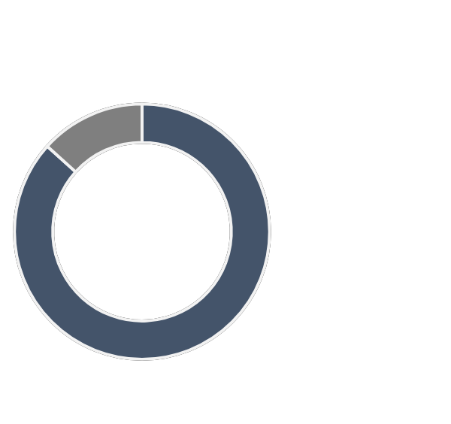
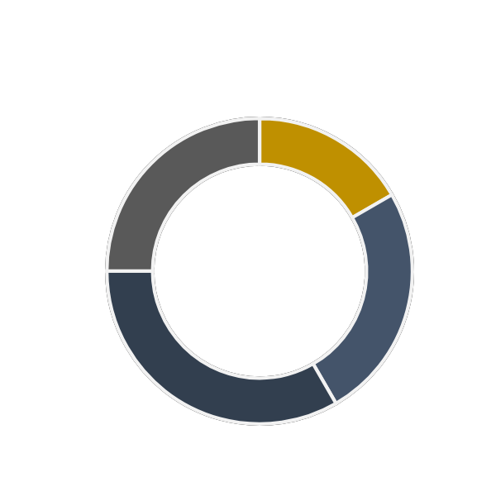
4 | Hubs & Accelerators
Several international accelerators have been active in Kenya in the past few years such as Y Combinator, 500 Startups, Startup Bootcamp, Catalyst Fund, GSMA Innovation Fund, Google for Startups, and Alibaba’s African Business Heroes, .Google, Startup Wise Guys, have indicated their interest and increased their presence in Kenya, as part of a goal to support 10,000 startups in Africa for the later. Several of these have onboarded Kenyan companies that have gone on to raise significant amounts of capital thereafter, examples are MarketForce that completed the YC program in 2020, Kidato that got accepted in 2021, Boya. Wasoko (formerly Sokowatch) went through the Catalyst Fund and Endeavor.
3.1
SURVEY FINDINGS
Majority of accelerators and hub that responded had local operations (87%) with only 13% having international operations. This reflects the large number of local accelerators operating in the country. In terms of number of years of operation, the largest proportion of Accelerators have been in operation for between 4 to 6 years and above 10 years. No accelerator has been operating for less than a year. This could be an indication that new accelerators aren’t sprouting up fast enough to meet the demands of the growing number of startups.
Fig x: Area of operation, Local vs International
Fig x: Years in Operation
13%
Operate internationally
25%
Above 10yrs
17%
1-3yrs
87%
Operate Locally
25%
4-6yrs
13%
7-10yrs

Slide 48
4 | Hubs & Accelerators
IMPACT ON FORMATION OF STARTUPS
Accelerators and hubs support startups in several ways depending on the focus area of the hubs. Sote Hub and SOMO provide training support for entrepreneurs while some (Nairobi Garage and Mombasa works) provide co-working and office spaces. Vilgro Africa and Chandaria business center help startups find suitable investors is specific sectors like Agriculture (Villgro Africa). It is a combination of these support structures and services that have enabled more startups to emerge .Hubs and accelerators that participated in this survey reported different impacts with regards to the number of startups that have been formed through their various programs. The Impact varies in terms of number of startups emerging from as low as 20 startups to as high as 900+ startups. Some hubs, those offering training support (SOMO, KIRDI) have also been included under this section. The impact for each of the Accelerators and hubs has been summarized and presented below.
Fig X: Number of Startups that have emerged due to support services
250
Startups
900
Startups
50
Startups
30
Startups
200
Startups
24 - 30
Startups
150
Startups

Slide 49


































































75 KENYAN PRIVATE HUBS & ACCELERATORS
Turkana
Garissa
3
Eldoret
2
Nairobi
45
Mt. Kenya
1
Turkana
Busia
1
1
Garissa
Kisumu
7
4
Mombasa
2
Taita
Taveta
Nakuru
1
1
Kiambu
Kisii
7

Slide 50
4 | Hubs & Accelerators
FINDINGS FROM THE SURVEY
A total of 15 hubs were interviewed as well as ASSEK. The study also encompassed feedback on hubs, accelerators, incubators as part of the surveys. There is no clear delineation between the incubators, accelerators and tech hubs within the study. It was noted that the roles and activities of the three were found to be interlinked. Accelerators were taking on startups with new unproven but exciting concepts, whilst incubators had companies that were already generating revenue but needed support. Many of the startups had no technology element and could be considered as SMEs in the traditional model. All three were involved in providing collaborative work spaces and competence building centers focused on knowledge and capacity building, scaling up, promotions and linkages with other players, industry and advisors.
Some of the observations and changes experienced in the past 10 years by accelerators include:
Early startups have found it difficult to raise funding - “brutal in the sense of process of starting the startup, funding, market for their products”
Hubs and innovation centers rose as a result of the introduction of 3G and fibre optics that democratized the internet
Over the last 10 years hubs have become more focused on specific sectors. e.g. agriculture, circular economy, insurance, health etc. focused
Proliferation in venture capital growth and emergence of locally owned funds and founders that have raised capital previously to fund and work with startups
Rise in hackathons and applications, demo days, conferences that focus on technology, impact such as Sankalp which has been run by Intellecap, fintech and others
Decentralization of innovation spaces with advise being sought globally by many startups founders based in accelerators e.g Catalyst Fund, GSMA, innovation labs created by UN etc
Many startup founders also run other side hustles to make ends meet and therefore do not have the focus on getting their startup off the ground, there by leading to failures
Kenyan start up founders need to shout out their successes to encourage other innovators and entrepreneurs and speak more about their journey
There has been a significant increases in youth led startups, however this represents a challenge in attracting serious funding in most cases as the founders are not deemed to be experienced enough
There has been misalignment of expectations from both donors and the recipients
Valuation have become very high over the past 5 years and there are more angel investments being done to meet valuation expectations, thereby investors are willing to take higher risk
Many local and international VCs are talking to hubs to find deal flow
Lack of motivation and mis-management of funds
Costs are subsidized by donors for both hubs and startups
Few women only focused hubs such as AkiraChix, however many hubs run women focused programs with inter-collaboration between the hubs

Slide 51
4 | Hubs & Accelerators
Many of the hubs, accelerators and incubators in Kenya are less than 5 years old and have not built the track record and knowhow gathered through experience. The early stage nature of the hubs in the ecosystem, indicates that there are significant opportunities for learning and development to build effectiveness, be self sustainable and successful and have longevity.
GAPS AND CHALLENGES
Many co-working spaces are un-sustainable financial models, which could be challenged if reviewed in a few years time. Lack of continuous capital to run the hubs as most are not sustainable without funding
Lack of data or willingness to provide data on measurement on impact, success and failure rates of cohorts. Developing robust systems and enforcing this into the DNA of a hub would enable the wider community to understand the effectiveness of the hub
Low growth rate experienced at many hubs by startups and by the hubs itself
Lack of capacity at the hubs in terms of funding, adequate skills and high caliber of operators and the need to recruit talent into and upskill management of hubs and startups
Mentors do not have adequate time to provide to startups even though the startups are distributed well, thereby lowering the effectiveness of the programs
Infrastructure in many of the hubs is inadequate from skilled personnel, ability to provide the service that the startup actually requires to linkages to funding, industry and advisors, rending the hub to just a being co-working space
Ability to synchronize the voice with government, donors, investors and other stakeholders in the ecosystem to adequately and successfully deliver the mandate by he hub
High cost of doing business for startups, making it difficult to do business
RECOMMENDATIONS
Build a community that can support startups (internally and externally), build partnerships with government, academia, donors and investors and subject matter experts to act as intermediaries and navigate gaps
Ability to provide linkages and encourage building of key management and founding team in startups that are well balanced in skills sets and compatibility
Building inter-hub relationships to avoid duplication of services and enhancing best practice within
Partnerships with mainstream and digital media to improve visibility of the hubs and the startups that work with them
Work with local VCs and angel networks to catalyze funding and business support for early stage startups
Build partnerships with mentorship programs that can be paid for or donor funded and platform to attract mentors who wish to be more involved
Hubs need to have their programs independently audited, reviewed and critiqued through a 360 degree process by advisors, investors and startups to ensure programs are effective
Increase in automation of services and outsourcing to industry experts may decentralize the manpower needed within the hubs and encourage a larger number of startups to be admitted
Ability to create innovative funding models to support promising startups such as credit guarantees, revenue shares, equity models
51

Slide 52

5
ACADEMIC INSTITUTIONS

Slide 53
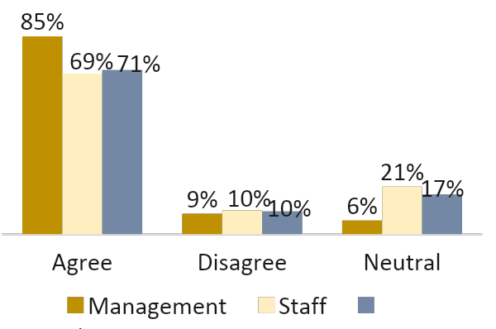
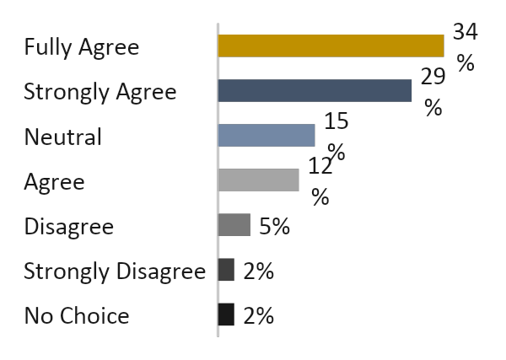
5 | Academia
Universities are key stakeholders in the ecosystem with their ability to provide an apt breeding and transformation ground for research, innovation, entrepreneurial skills and capacity building
“Over the past two decades, there have been growing calls for universities to become more accountable to the wider public and to contribute directly to the local, regional and national economic development through taking on a range of “third mission” activities such as incubation of start-up firms, knowledge commercialisation, the development of knowledge transfer partnerships and providing entrepreneurship courses¹”
  Joe Mucheru - ICT, Innovation and Youth Affairs Cabinet Secretary
Some of the largest academic institutions in Kenya initiated incubation centres more than a decade ago, such as iLabAfrica (Est. 2011) at Strathmore University, Chandaria Business Innovation and Incubation Centre (Est. 2013) at Kenyatta University, Nailab and C4DLab (Est. 2013) at University of Nairobi. The ability to identify talent and provide them with resources, key partnerships, linkages with businesses, funding, advise and other services to enable commercialization of an idea would be a game changer, spurring a shift in mindset from employee to employer.
This study used a stratified random sampling methodology to select 21 universities from a population of 70 private and public universities. It then identified three respondents in each institution who included students, staff, and management. Kenya is faced with a high number of graduates being unemployed, attributed to weak academic-industry linkages². Universities are working to address this gap.
Fig X: Mechanisms in place for breaking down traditional boundaries and fostering new relationships
85% of universities management agree that the universities have mechanisms in place for bringing stakeholders together and building synergies, whilst more students seem to agree at 71% versus 69% for management
With around 562,000² students enrolled in 2021/2022, focus on these graduates being adequately skilled to empower them for entrepreneurship is critical to achieve Sustainable Development Goals.
Fig X: Entrepreneurship integration as a major part of the University's mission and strategy from Students Perspective
75% of students agree that universities are keen on integrating entrepreneurship as part of the University’s mission. Only 25% of the students do not agree or are neutral
53
https://www.kenyanews.go.ke/cs-mucheru-challenges-universities-to-establish-business-hubs/
https://unesdoc.unesco.org/ark:/48223/pf0000381538
https://www.statista.com/statistics/1135785/university-enrollment-in-kenya/

Slide 54
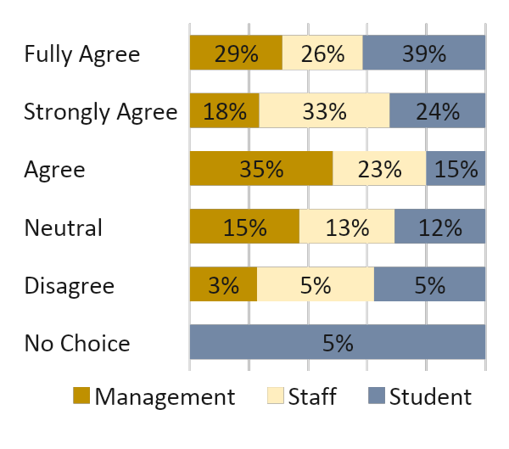

5 | Academia
Mixed reactions between various stakeholders in universities seen in the charts below, indicating there is a need to improve entrepreneurial learning, support within universities.
Fig X: The universities are active in developing initiatives and programs that drive entrepreneurship development in the wider regional, social and community environment
Fig X: Entrepreneurial behavior is strongly supported throughout the university experience; from creating awareness and stimulating ideas through to development and implementation
22% of the students feel that universities are not active in developing initiatives and programs that drive entrepreneurship
34% of the students feel that entrepreneurial behavior is not adequately supported by universities
Industry, academia and incubator linkages are being strengthened globally to attract talent and encourage research and collaboration. Some of Kenya’s academic institutions have partnered with top academic institutions and corporates that can provide knowledge sharing, skills enhancement and mentorship to build local capacity, e.g, Strathmore has partnered with MIT’s Global Startups Lab, with Oracle to work on Africa Media Hub, Yale-Strathmore Leadership Forum in 2018 amongst others
Fig X: The universities have strong links with incubators, science parks and other external initiatives, creating opportunities for dynamic knowledge exchange
 | No Choice | Strongly Disagree | Disagree | Neutral | Agree | Strongly Agree | Fully Agree
Management | 0% | 0% | 3% | 24% | 26% | 18% | 29%
Staff | 0% | 8% | 10% | 18% | 36% | 13% | 15%
Student | 5% | 7% | 5% | 10% | 12% | 32% | 29%
36% of the universities staff either disagreed or were neutral on the linkages within universities with other initiatives, higher than students at 27% and 26% for management.

Slide 55
5 | Academia
Fig X: The universities actively encourage individuals to become entrepreneurial
 | No Choice | Strongly Disagree | Disagree | Neutral | Agree | Strongly Agree | Fully Agree
Management | 0% | 3% | 6% | 38% | 32% | 12% | 9%
Staff | 5% | 5% | 15% | 38% | 15% | 5% | 15%
Student | 5% | 5% | 5% | 10% | 17% | 32% | 27%
Only 36% of the staff felt that the university encourages individuals to fulfil their entrepreneurial interests, 64% of staff taking the view that universities actively raise awareness of the value/importance of developing entrepreneurial abilities amongst its staff and students
Most academic institution labs, incubators and hubs are led by highly qualified academic staff, with limitations in their experience of working in industry or business. This limits their ability to adequately mentor startup founders and students, unless there is a collaborative effort in conjunction with industry players. The need to enhance skill sets and recruit key leaders from the global business community to provide mentorship and guidance as well as build capacity within the universities is important to ensure the success and longevity of such programs.
Limitations in budgets provided to the academic incubators and hubs also impact the level and caliber of management within these hubs. Many of the incubators, hubs are funded by donors (DFI’s, family offices, impact investors) and run on a small budget. More recently, larger budgets have been established to promote youth employment and leadership development by organisations such as USAID and The Mastercard Foundation amongst others.
Fig X: The universities entrepreneurial objectives are supported by a wide variety of funding sources/investment, including investment by external stakeholders
 | No Choice | Strongly Disagree | Disagree | Neutral | Agree | Strongly Agree | Fully Agree
Management | 0% | 3% | 9% | 26% | 35% | 18% | 9%
Staff | 3% | 3% | 13% | 21% | 28% | 15% | 18%
Student | 5% | 2% | 10% | 7% | 24% | 22% | 29%
69% of staff and 85% management indicate that they agree that there are a wide variety of funding sources including external sources available to promote entrepreneurship within universities
Universities in Kenya are involved in innovation with a number applying for patents with the Kenya Industrial Property Institute (KIPI), the body established to register and grant patents in Kenya. As established in the Industrial Property Act no. 3 of 2001 that established KIPI, the inventor has the right to a patent. When the inventor is an employee who used data or resources available during employment, that right is established with the employer. The law goes on to state that the employee has “a right to equitable remuneration taking into consideration his salary and the benefit derived by the employer from the said invention” in the event the invention is of “exceptional importance”. (Industrial Property Act, s30(1), 32(1)).

Slide 56
5 | Academia
The administration and remuneration provisions are established through institutional intellectual property policies which a number of universities in Kenya have in place. These policies offer also guidance on commercialising of innovation. Many students and innovators sign up to academic incubators and hubs for this reason.
GAPS AND CHALLENGES
Lack of data or willingness to provide data on measurement of success and failure rates of cohorts within university hubs. Enforcing this into the DNA of a hub would enable the wider community to understand the effectiveness of the hub apart from being only a training entity
Insufficient capacity at many incubators and hubs to provide specific guidance such as digitalization skills, route to market, ability to provide independent advise in comparison with other products or similar solutions in the market, At times inability to provide sufficient support for innovations due to lack of network or muscle to promote the startup
Insufficient access to fund raising from local and international venture capital, local debt providers, grant makers, angel investors and corporates
Focus on agriculture, education, FMCG and commerce led projects largely within certain universities. Many of these focused on the economic activity carried out within the regional environs.
Many of the founders have the outlook of a traditional business with an innovative product but lack commercialization and uptake or a product or service without the high scalability factor that is vital to being classified as a startup
RECOMMENDATIONS
Foster strong partnerships and build relationships with external hubs for knowledge sharing, improving access to resources with other accelerators globally, VCs, corporates, marketing agencies, local authorities and bodies that support startups, having them involved and buying in earlier on
Attract a wide variety of skill sets from different industries, enhancing mentorship opportunities with key business leaders, access to workshops with top universities, hubs and individual market leaders. Organise conferences, bootcamps, pitch days, demo days, hackathons, competitions to create an effective feedback loop
Build internal capacity of current leaders to effectively and sustainably manage the centres and hubs.
Build capacity on intellectual property rights with access to the top legal community
Strong links with software engineers and developer communities in Kenya and globally to provide adequate feedback loops
Enhance ability to identify disruptive innovations
Ability to selectively admit external students in the incubation centres
56

Slide 57





























UNIVERSITY HUBS & ACCELERATORS
1
1
Nyahururu
Njoro
Est. 2020
Est. 2021
Eldoret
Est. 2016
2
Est. 2019
2
Meru
Est. 2020
Est. 2013
Bungoma
1
Est.
Est. 2021
Chuka
1
Kakamega
Est. 2015
1
Est. 2013
Bondo
Karatina/ Nyeri
2
1
Narok
1
Est. 2019
Est. 2013
Kisumu
Est. 2015
2
Est. 2016
Mombasa
1
Est. 2011
Est. 2021
11
Ruiru / Thika
Nairobi
Est. 2015
2
Est. 2018
Est. 2013
Est.
Est. 2022
Est. 2011
Est. 2017
Est. 2020
Est. 2017
29
University Hubs and Accelerators
Est. 2014
Est.
Est. 2016
Est. 2012

Slide 58
5 | Academia
KEY TAKEAWAYS: “QUADRUPLE HELIX MODEL¹”
With technology disrupting all sectors and industries, universities are one of the most important players of promoting economic development. The triple helix model is a spiral model of innovation, which brings together government, industry, community and academia for development framework developed by Henry Etzkowitz and Loet Leydesdorff in 1990s.
Spin offs from universities have recorded USD 39.3bn² in 2021, a 72% rise from the previous year, according to Global University Venturing (GUV), a market intelligence agency, as a result of increased interest in “deeptech” that supported by universities but are high risk and require patient capital to commercialization
An example of success using model is the technical university TUM in Munich, Germany which is attached to several institutes. The state has investment EUR1bn and the BMW family office have also invested to set up an incubator that has invested in 50 companies in the region. In 2014, Safaricom had invested KES 30m in iLabAfrica to spur technology growth and innovation and work with companies that could be used to scale. Whilst this does not return positive results at the time, with the startup ecosystem exploding locally and globally in the past 5 years, the model is worth re-exploring.
  “ Safaricom is now seeking to actively orchestrate the quadruple helix model of innovation that incorporates the academia, government, communities plus hubs and the industry. As part of this initiative these hubs will benefit in terms of shaping their governance, embedding innovation frameworks and capacities as well as leveraging various ecosystem networks in the arrangement”
  ~Eng Andrew Masila, Head of Innovation Technology and Design - Safaricom
Cultivating links between research communities and industry and extending beyond this to encompass other segments would strengthen the academic institutions capacity as well as increase the ability of industry to solve for more complex problems locally
It was noted that during crisis or downturns, newcomers and individuals and corporates were more willing to partner to undertake radical innovations, for instance, many universities based makerspaces in Kenya building low cost ventilators at the onset of Covid19
The capacity building that will be required within education institutions will need patient capital to promote the innovations built in house, a circle of coexistence between startups and corporates and strong networks (regional, global, interpersonal, campus) as bridging assets and nodes to validate ideas, concepts and commercialisation³
https://www.emerald.com/insight/content/doi/10.1108/REGE-04-2021-0077/full/html
https://www.fdiintelligence.com/content/feature/economic-development-links-to-university-spinout-boom-80867
https://www.frontiersin.org/articles/10.3389/fpsyg.2021.732388/full

Slide 59

6
GOVERNMENT

Slide 60
6 | Government
6
GOVERNMENT
The Kenyan government has played a strong role in signaling its support for the development of the country’s startup ecosystem by supporting the creation of acts and laws to better protect startups. The introduction of 3G internet in 2010 by the Kenya Government was instrumental in catalysing an explosion of the sector, and coincided with the mushrooming of technology hubs that were the hallmark of the sector development.
A UN E-government survey in 2020 indicated Kenya’s position¹ for online services at 67%, telecommunication infrastructure at 34% and ICT human capital at 58%. Kenya ranked an overall global position of 116 out of 193 countries surveyed in the UN eGovt Index, behind South Africa that was ranked at 78, Seychelles at 76 and Namibia at 104. The ranking indicates the significant amount of work that the country will need to accomplish to be recognized as continental leader in the Digital Government domain.
Through the Kenya National Digital Master Plan 2022–2032¹, a progression from the ICT Masterplan of 2014-2017,the Government aims to streamline interoperability of the country’s technology assets and government programs. A focus on development of policy, legal and regulatory framework, research and development as well as information security, cyber management and emerging technologies are highlighted. The financial resources required to execute the masterplan amounts to KES 484.2 billion (USD 4 billion or GBP 3.5 billion).
The National Digital Masterplan is intended to be implemented through an oversight committee chaired by the President, subordinating to an inter-ministerial steering committee, the ICT authority thereafter and filtering down to the individual ministries. The synergies between the Governmental bodies and other agencies that support the ecosystem. Some key institutions and agencies that the government works with are outlined here below:
The Kenya National Innovation Agency (KENIA) under the Ministry of Education in mandated to develop and manage the national innovation system through the Digital Innovation Enterprise and Digital Business pillars
The KONZA Technopolis Development Authority (KOTDA), launched by the Government as an initiative of vision 2030, to create a smart city by building digital infrastructure, services, data management, skills, innovation and entrepreneurship
The National Commission for Science, Technology, and Innovation (NACOSTI) regulate and assure quality as well as act as an adviser to the government in matters thereto.
The Kenya National Spatial Data Infrastructure (KNSDI), a national initiative that strives to provide better access to spatial data for better analysis and decision making
https://cms.icta.go.ke/sites/default/files/2022-04/Kenya%20Digital%20Masterplan%202022-2032%20Online%20Version.pdf
https://assek.ke/

Slide 61
6 | Government
Achievement highlights from the National Digital Masterplan from 2014 that impact the startup ecosystem include development of 8,900 km of fibre optic infrastructure and digital skills development through 21,000 Presidential Digital Talent Graduate internships, 92,000 youth under Ajira Digital jobs initiative and over 15,000 civil servants trained.
By 2012, independent innovation hubs came into significance, along with the rise of token based hackathons supported by corporates. The initiation of 187 constituency innovation hubs (CIHs) by the government further bolstered the activity at grassroots level, and positioned such hubs to be an integral pipeline for the sector. At present about 26 CIHs from 17 counties have come together to form through the Association of Startups and SME Enablers in Kenya (ASSEK) to enhance innovation and support startups^{2.}
Some counties have been noted to be quite active in promoting access to digital services and markets, mentorship as well physical space to work for instance Laikipia County, Kisumu county, Mombasa county, Uasin Gishu, Makueni amongst others. Regular information sessions are held once a month, inviting business leaders to interact with local entrepreneurs to foster growth and investment.
Counties have in addition to the CIHs developed other programs to support entrepreneurs and foster innovation such as Laikipia Innovation and Entrepreneurship Fair and the Makueni Innovation Challenge to catalyse, scale and grow startups and entrepreneurs in individual counties. County Innovation weeks in Kisumu (Lake Basin Innovation Week) and Mombasa (Pwani Innovation Week) that have emerged in the past 3 years, have been instrumental in showcasing local innovations.
.
In addition, the Kenya Innovation Week, organized by Kenya Innovation Agency (KeNIA) since 2021, provides access to countrywide entrepreneurs and fosters dialogue, policy formation, donor support and investments.
Another Government initiative, Whitebox² is a channel to provide a product or service to the Government and the intention is to provide a one stop shop to promote localised innovations as well as provide access to markets, investors and government. Around 1861 users have been supported by the program with 342 innovations cutting across housing, health, manufacturing, food security and others.
Initiatives to support innovators have gained momentum with additional funds allocated to youth fund programs such as:
Youth Enterprise Development Fund (revolving fund that is aiming to have disbursed KES 16.17 billion/ USD 134 million/ GBP 116 million) by FY2023/2024)
UWEZO program (KES 7.1 billion/ USD 59 million/ GBP 51 million in loans disbursed with funding provided to 1.2 million youth); and
Kenya Youth Employment Opportunities Project (USD 150 million / GBP 129.8 million program that ended in 2021 to increase employment amongst youth, improve information systems in the labour market and strengthen youth policy development)
61
https://www.uwezo.go.ke/
https://assek.ke/index.php/media-centre/blog

Slide 62
6 | Government
2022-2032 GOVERNMENT DIGITAL MASTERPLAN FLAGSHIP PROGRAMS
1
100,000 kms of fibre optic cable (52,000 for Government, 48,000 for private networks) – 25,000 public hotspots in rural areas, 24,000 village digital hubs and studios
KONZA Technopolis – Data Centre and Smart City
Establishment of regional ICT hub
Digital Infrastructure
2
Digitisation of all critical services, includes digitization of 5 billion records
Integration and interoperability of Government services
Develop Government security and intelligence and surveillance systems
Digitisation of 25 billion records (around 500 million per county)
Digital Services, Products and Data Management
3
Digitisation of all critical services, includes digitization of 5 billion records
Integration and interoperability of Government services
Develop Government security and intelligence and surveillance systems
Digitisation of 25 billion records (around 500 million per county)
Digital Skills
4
Establishment of 10 regional ICT and innovation centres of excellence
National physical addressing system
Software industry establishment
ICT research hub
Digital Innovation, Entrepreneurship, Digital Business
5
Research and Development
6
Information Security and Cyber Management
ICT research hub establishment
Establish and operationalize a cyber –security centre of excellence
62
http://www.kiep.go.ke/
https://www.whitebox.go.ke/

Slide 63
6 | Government
6.2
INSTITUTIONS
Two of the most active players and institutions in the Kenyan investment market are the Nairobi Stock Exchange and the Capital Markets Authority. With the vibrancy of the startup sector in the past 5 years, the two institutions are playing a key role in startup ecosystem.
PUBLIC CAPITAL MARKETS - THE NAIROBI STOCK EXCHANGE (NSE)
REGULATOR – CAPITAL MARKETS AUTHORITY (CMA)
The Nairobi Stock Exchange is a leading securities exchange market in Sub-Saharan Africa. In 2014, the NSE demutualized and self listed.
The NSE has provides access to private placements and public capital markets, with the governance structures that are prudent for startups to adhere to. To facilitate smaller companies with lower regulatory barriers than the main market, the NSE has provided a friendly platform. called the Growth Enterprise Market Segment (GEMS) that would be able to meet the needs to growth focused startups that are looking to raise capital with specific requirements.
Several companies have raised capital through the GEMS platform and many technology companies will be looking at alternative means of funding as VC funding becomes tighter. The anticipation is that as companies in Kenya mature, their earlier investor may be able to exit via the GEMS platform and the NSE is positioning the platform as the
In 2021, The NSE signed a partnership with the Konza Technopolis Development Authority (KoTDA) to connect the Kenyan Startups with potential investors¹. This was part of the knowledge economy and innovation program of KoTDA’s strategic plan for startups and SMEs. This symbiotic relationship is an example of how government and private sector players can come together.
The CMA, established by an Act of Parliament to regulate the capital market in Kenya, plays a role in the startup ecosystem through the regulating private equity and venture capital registered and operating in Kenya through the Capital Markets Registered Venture Capital Companies Regulations 2007. and therefore affects access to capital by startups.
The CMA also operates a sandbox - a favourable, tailored regulatory environment that allows for the live testing of innovative fintech capital market related solutions, products and services prior to launching in the mass market and regulated by the Regulatory Sandbox Policy Guidance Note (PGN), 2019. The adoption of sandboxes signifies the governments commitment towards innovation and its willingness to support upcoming fintech solutions that will be used by the Kenyan public.
As of December 2021, the CMA had admitted 12 startups to the live testing environment. Among the startups in the regulatory sandbox are Acorn Investment, Waanzilishi Capital, KOA, Pezesha and Moneto Venture Capital. An analysis of the CMA sandbox reveals the shows that five firms have exited the sandbox: Innova, Pezesha, Genghis, CDSC, and Fourfront Management. Innova and Pezesha exited the sandbox in 2019. CDSC and Fourfront Management successfully exited in 2020. Seven startups are currently undergoing the program: Waanzilishi, Acorn, Sycamore, Koa, Moneto, Belrium, and Pyypl.
https://konza.go.ke/2021/10/25/konza-technopolis-development-authority-seeks-to-partner-with-the-nairobi-securities-exchange/

Slide 64
6 | Government
6.3
THE ROLE OF NATIONAL AGENCIES
A survey on 13 government agencies revealed major insights about their views on the startup ecosystem. The insights covered among other things; agency view on startups, services provided to the ecosystem, challenges faced in supporting startups among others. The survey sought to determine the type of support these agencies offer startups then to determine the recommendation these agencies would want implemented to further strengthen startups ecosystem in Kenya. The following table summarizes the agencies locations and core services offered to startups in the Kenyan Ecosystem.
Table x: Government Agencies location and services offered to startups in ecosystem in Kenya
Organization | Location | Services Provided to Startups
State Dept. of Industrialization | Nairobi | Policy formulation Coordinating government agencies
KWTA | Eastern Region | Capacity building Financial support
KENAS | Nairobi | Accreditation of conformity assessment bodies
KEBS | Nairobi | Standardization Training Metrology Conformity assessment services
TVET | Nairobi | Skills development including digital skills
NACOSTI | Nairobi | Issuance of research licenses Setting STI research priorities Regulate research institutions supporting start-ups
KIE | Nairobi | Industrial development incubation services, Credit for micro, small and medium enterprises Business advisory services, subcontracting and linkages
KIPI | Nairobi | Protection of intellectual property rights
KEPROBA | Nairobi | Capacity building Awareness creation on product development Adaptation with a bias to exports
MSEA | Nairobi | Incubation and mentorship Capacity building Registration of MSMEs and associations Access markets through fairs and exhibitions
ASSEK | Country Wide | Capacity building for Hubs, Accelerators, Incubators Set standards and policies for the hubs under its umbrella Advocacy and public education with a focus on SMES Represent interests of startup ecosystem stakeholders
KONZA | Outskirts of Nairobi | ICT infrastructure and smart city establishment Incentives for setup at KONZA Partnerships with
SME Advisory Unit | Nairobi | Development of SME focused ecosystem Engagement and co-ordination of key players into the ecosystem both public and private
64

Slide 65
6 | Government
6.4
SURVEY FINDINGS
Significant gaps exist in terms of policy formulation and its implementation within the startup ecosystem in Kenya. The survey sought to get government agencies’ opinion on what recommendation should be put in place to strengthen the ecosystem and help startups accelerate more to reach profitability levels. Some of the suggestions provided by various agencies are highlighted below:
Table x:Recommendations for improvement of the startups ecosystem
Organization | Recommendations to Improve the Startups Ecosystem
State Dept. of Industrialization | Build mutual working relationship between private and public sector startup ecosystem players Mentorship program
KWTA | Embracing new technologies
KENAS | Adequate financial support Create more awareness Professional association for start ups
KEBS | Embrace quality and capacity building in their programs
TVET | Entrench values among staff
NACOSTI | Improve access to information and opportunities Mainstream commercialization of research outputs Marketing of existing government initiatives e.g TVET fairs
KIE | Promotion and sensitization of public private procurement processes Advocate on flexible regulations to set up businesses Increase credit support for start-ups Provision of business development and mentorship services Improve linkages programs
KIPI | Engagements to reduce cost of doing business Support startups through funding
KEPROBA | Credible identification and selection of startups
MSEA | Provide more mentorship programs and start up incubation centers Lobby for favorable government policies on startups Increase funding for startups
ASSEK | Focus on creating a soft landing for startups Focus on mid level entrepreneurs and management
KONZA | There is need to have innovators interact and have their ideas critiqued objectively by professionals and investors Vibrant policy to help startups thrive Showcase successful startups and celebrate successes
SME Advisory Unit | Encourage startups to seek government support where needed Build capacity of entrepreneurs through the right standard of education and experience, stemming from educational institutions
65
https://www.ecofinagency.com/finance/2710-43132-kenya-nse-reaches-deal-to-connect-tech-start-ups-with-potential-investors

Slide 66
6 | Government
6.5
GAPS, CHALLENGES AND RECOMMENDATIONS
GAPS AND CHALLENGES
Various governmental organisations have been and are working in siloes with little or no co-ordination on activities, programs, incentives related to startups, thereby duplicating various activities and services and resulting into wastage of resources
Government faces difficulty in defining startups and typical bundles SMEs with startups
Lack of sufficient recognition as a key economic driver to merit the adequate attention it requires. Informality of the SME and startup sector makes it difficult to regulate and form polices around the working of the entities
Lack of tech talent in the ecosystem, forcing local startsups to hire talent from abroad
Low digital skills literacy within the citizens coupled with high demand for ICT qualified employees
Poor alignment to increased digital and management skills requirements within their teams from industry players by Universities
Local companies needing to register offshore such as in Mauritius and Delaware, impeding investment from local investors. This is largely to facilitate foreign investors and growth outside of Kenya, however it shifts focus from being a Kenyan company
RECOMMENDATIONS
Opportunity to find cohesive and all inclusive pathways to work with startups and collaborate with private sector players, investors, donors and academia to grow the local startup ecosystem further with active participation and direction
Provide stronger support for commercialization of research and innovation from Universities, TVETS and research organizations
Provide support and incentives to attract, retain and promote skills transfer strong technology talent
Direct investment or backing of innovations that have high growth potential and strong impact from the economy similar to the case with Safaricom and Mpesa
Encouraged by the progress of the CMA sandbox, a recommendation would be to foster more localized or county based Government sponsored sandboxes to provide an enabling environment that has a positive impact on the economy and can provide a real solution to a problem faced at a country level and enable the startup to easily overcome regulatory challenges
Adequate security systems for investor funds to encourage investors to do business in the country by reducing the regulatory burden on entrepreneurs
66

Slide 67
6 | Government
6.5
GAPS, CHALLENGES AND RECOMMENDATIONS
GAPS AND CHALLENGES
Lack of sufficient quality data on number of startups and the whole ecosystem has made in difficult for government to channel the right amount of funds to help support the sector in the country
Access to information is a challenge and outdated, incomplete data sets could be used in decision making
Disorganized funding systems with duplication of roles among government institutions
ICT infrastructure and installation in smaller towns and the rural areas of country have had slow growth as compared to the cities
Cumbersome, disjointed and laborious government process and regulation slowing down the growth of startups and registration of startups and SMEs as formal entities, thereby limited their potential for growth
Digital exclusion amongst marginalized groups due to lack of access, skills, awareness and low mobility
RECOMMENDATIONS
Consideration on providing tax incentives to investors and tax breaks for startups
Provision of more training opportunities to enable startup entrepreneurs necessary skills in fields of business management and investor readiness. Structured programs should be created aimed at mindset transformation
Awareness and advocacy on services, programs and grants available to startups
Ensuring that Universities have good systems in place to support ideas in terms of intellectual patents management and appropriate policy frameworks and appreciation of commercialization
Monitoring and maintaining startup trends and records that are accessible and available to ecosystem players
Strengthening real and near time data collection and systems to gather startup data collection for better analysis and decision making
Providing government support such as enhanced, larger and concessionary pools of credit guarantee schemes or loan schemes that can enable the startup to grow in a soft environment
67

Slide 68

7
POLICIES

Slide 69
7 | Policies
7
POLICIES
Although there has been rapid activity in the Kenyan startup ecosystem in the past years, the major challenge remains the regulatory framework put in place by the government which has hindered investments and potential growth. The survey shows that investors point to policy and regulation challenges as the main obstacles. To open up and connect economies, African governments need to rapidly build and deploy a digital economic policy ¹. In doing this, three key challenges should be addressed, financing, strengthening support networks and improving business environments. The Kenyan government has however made some strides towards proper facilitation of investors and protection of startups.
The Government initiated the STI Act of 2013 to replace the former Act of 1997, which did not integrate the aspects of innovation.
To ensure promotion, coordination and regulation of the STI process, quality, funding and advisory linkage mandate, three arms whose roles are very discrete to one another were created in the recent ST&I Act, 2013.
Some of the Acts that were put up by the government to this end have already been covered in this report such as the ST&I Act of 2013 and the National Research Fund Kenya. The Micro and Small Enterprises Act of 2012 was created to regulate micro and small enterprises. Among its objectives were providing an enabling environment, facilitating development services for MSEs and facilitating formalization of the MSE sector. Perhaps the greatest policy is the Startup Act of 2020 which was published on 14th September 2020. With this Act, the government aims to develop a number of incentives for startups. The Startup Bill 2020 provides a framework for the development of innovative entrepreneurship, establishing incubation hubs, and building a network of global and regional investors.
CASE STUDY
STARTUP POLICY HACKATHON
To respond to the various challenges expressed by early stage businesses in Kenya, the Ministry of Industry, Trade and Cooperatives – State Department of Industrialization hosted a Startup Policy Hackathon which was coordinated by the SME Advisor and modelled on the Global Entrepreneurship Network. The hackathon identified the five Key pressing challenges for startups and recommendations of solving the problems identified. Policies that were recommended
Formation of the Policy Teams to develop the draft Policy Proposals
Stakeholder engagement workshops led by Policy Team Leaders from stakeholder institutions
Develop of an MSME Digital Portal/One Stop Shop
Enabling policies to increase and diversify the financing tools for early stage funding:
69
https://institute.global/policy/supercharging-africas-startups-continents-path-tech-excellence
https://www.industrialization.go.ke/index.php/policies/99-micro-and-small-enterprises-act-2012

Slide 70



7 | Policies
7.1
SURVEY FINDINGS
6.1.1 THE STARTUP BILL
Ecosystem players (investors, startups and SMEs) gave their views regarding the drafted Startup Bill expressing their thoughts on whether the bill addressee the current challenges facing the ecosystem.
The largest proportion of investors (61%) disagree that the bill addresses challenges with only 7% agreeing. For startups, The largest majority are indifferent about the Bill. SMEs have the largest proportion agreeing that the Bill will address the challenges.
Fig X: Investors’ opinions on whether the Startup bill addresses ecosystem challenges
Fig X: Startups opinions on whether the Startup bill addresses ecosystem challenges
Fig X: SMEs opinions on whether the Startup bill addresses ecosystem challenges
Neither Agree nor disagree
Agree
Disagree
Only 7% of investors think that the Startup Bill will address Ecosystem Challenges.
SMEs have the largest proportion (41%) agreeing that the Bill will address the Challenges
70
https://institute.global/policy/supercharging-africas-startups-continents-path-tech-excellence

Slide 71
7 | Policies
Government agencies were also asked to identify some of the policies that have been implemented by the government to help the startups.
Organization | Policies Implemented
State Dept. of Industrialization | Sessional Paper No.5 of 2020 on the MSEs Policy
KWTA | Buy Kenya Build Kenya;
KENAS | Digital innovations
NACOSTI | Science technology and Innovation Act of 2013; Science technology and Innovation regulations
KIE | The Draft Start-UP Bill; SDI has established Biashara Centers for work space and business information
MSEA | The draft start up policy; MSE policy
Table X: Government agencies View on policies implemented to enable startups
Some investors and startups already appreciate the efforts put in by the government. Gearbox, an initiative that aims at improving the ecosystem for hardware entrepreneurship by providing flexible working space, shared prototyping facilities, training in manufacturing, fabrication, and design, as well as mentorship, was a beneficiary of the Financial Management Act, which exempted local manufacturers of motherboards from 16% VAT. Gearbox said this was very significant as it helped them easily manufacture and gave them a competitive edge over international manufacturers. Some innovators (Flex Pay founder) have expressed negative feelings regarding the government’s requirement that all ICT practitioners must hold a university degree. The innovator says this will likely hamper more startups as innovations can come from anywhere.
An analysis of the startup The Kenya Ecosystem Bill reveals some shortcomings of the bill in addressing the challenges that face the Kenyan ecosystem. The Bill complicates the registration process by requiring that an entity first register as either a company, partnership, limited liability partnership, or non-governmental organization, after which the entity will be eligible for registration as a startup. This presents the problem of double registration. Further, the Bill disregards that the requirement for a start-up to have a patent or trade mark registered in Kenya may result in the exclusion of entities as most start-ups do not have enough capital to fulfil this condition. Comments from agencies like KeNIA suggest that the bill is a politically driven one where most of the stakeholders in the startup ecosystem were not involved in the drafting.
71

Slide 72
7 | Policies
Despite these shortcomings, the bill solves some of the ecosystem's problems. The Bill empowers the agencies to subsidize the formation of startups and also facilitates the protection of IP rights of innovations by startups. The Bill also provides fiscal and non-fiscal support to startups admitted into incubation programs and provides support to enable the development and growth of startups. The Bill provides for the establishment of a credit guarantee scheme for the development and growth of startups. A comparison was made between the Draft Startup Bill in Kenya and other countries like Tunisia (TN), Senegal(SN), Ethiopia(ET), and Nigeria (NG), which already have working policies. The comparison was performed on the incentive and grant matrix.
SUBJECT | ISSUES | TN | SN | KE | ET | NG
Incentives and Grants | Tax relief | ✓ | x | x | x | x
 | Granting of guarantees for obtaining credit | ✓ | ✓ | ✓ | ✓ | ✓
 | Government support (monetary or otherwise) | ✓ | ✓ | ✓ | ✓ | ✓
 | Access to private and public support/funding | ✓ | ✓ | x | x | ✓
 | Access to public order/ procurement | ✓ | ✓ | x | ✓ | ✓
 | Favourable investment measures |  | ✓ | x | ✓ | ✓
 | Implementation of capacity building measures | ✓ | ✓ | ✓ | x | ✓
 | Facilitating the grant or revocation of patents (Protection of IP) | ✓ | x | ✓ | ✓ | ✓
Table X: Comparison of the start-up Act (Law 20 of 2018) of Tunisia, Start-up Act (Law No. 2020-01 of January 6, 2020) of Senegal, Kenyan Start-up Bill 2021, Start-up Proclamation (No. of June 2, 2020) of Ethiopia and the Nigerian Start-up Bill, 2021
The tabled analysis shows that Kenya Startup Bill performed well across matrices like protection of IP, Implementation of capacity building measures, government support and Granting of guarantees for obtaining credit. However, in metrics such as Favourable investment measures, Access to public order/ procurement, Access to private and public support/funding and tax relief the Startup Bill did not performed well.
72

Slide 73
7 | Policies
GAPS, CHALLENGES AND RECOMMENDATIONS
GAPS AND CHALLENGES
Investors have expressed the difficulty and lengthy process of business registrations. There’s need to smoothen the process for startups and the creation of policies around this to distinguish startups from other enterprises.
Lack of tax rules to encourage investors and venture capital funds to invest in startups in the ecosystem. The country currently lacks tax policies governing tax payments for startups and angel investors.
Proper patenting and management if Intellectual Rights for inventions made within the country. Policies should be formed on these and proper channels established to ensure startups know steps to follow in registering their patents.
Policy benchmark is necessary from countries that have working ecosystems to help the country learn about ways the policy can be framed better
RECOMMENDATIONS
Provide update on policy benefits/amendments and help startups with their regulatory issues, by:
  Setting up a call center/cell, which could act as a one stop shop for any regulation specific query
  Establishing a shared services center which would provide accounting, technology, patents etc. related solutions
  Easing out registration and fund disbursement process and lead time.
Involve private players/startups/ industry experts in policy formulation and implementation by Enabling better collaboration and interaction between the startups, the government and industry experts, by introducing an online participation forum.
More participations in policy hackathons by those in governments to come to with better ways to form policies so as to build sustainable startups
Tax incentive policies for angel investors through creation of Angel tax incentives and Angle Investors Tax Deduction schemes to reduce the risks associated with early stage investments through tax exemptions
Creating policies that recognize the dynamism of the digital ecosystem by implementing regulations that are both dynamic and flexible.
73
73

Slide 74

8
INVESTORS, DONORS &
FUNDING

Slide 75

8 | Investors
8
INVESTORS
From 2008 to 2010, nearly 60 percent of investment in Sub-Saharan Africa was destined for South Africa, with regional hubs like Nigeria and Kenya trailing far behind in terms of both market share and mind share¹.
According to a study by GSMA in 2014, less than 10% of startups received funding from VCs or angels with only 7% of the VCs targeting ideation stage and 34% focusing on seed investments, with 60% bootstrapping completely. 40% of the startups received less than USD 1,200².
Venture capital in Kenya’s startup space were categorized into Commercial and Impact focused. There were 16 commercial VCs and 11 impact VCs² identified in the GSMA report in 2014. 44% of the these VCs (some of whom are: Kitendo Capital, eVA Fund, Amadeus Capital Partners, Fanisi, TBL Mirror Fund) are not active in Kenya or have closed down or not raised a second fund. One of the reasons for closing down or not raising a second fund has been the inability to successfully exit. Some of the fund managers and team members have moved on to work with other funds.
Some of the funds started with venture investments but also engaged in larger private equity type deals such as Leapfrog. Other longtime funds such as Accion, Acumen Fund, Bamboo, DOB Equity, TL.com continue to be active in the tech space and adding value in the Kenyan startup ecosystem.
400+ VCs, DFIs, Ventures Builders, Angels, Corporates and Syndicates invested in Kenyan startups between 2019 and first half of 2022. Kenyan startups attracted more venture funding in the first five months of 2022 (USD 820+ million) than it did in all of 2021 (USD 412 million)², indicating over 4x potential growth by the end of the year.
Startups in Africa attracted USD 3.1bn³ in the first half of 2022, with Kenya accounting for 25% of this amount. Pre-seed and seed rounds have been increasingly popular as higher valuations and increasing competition from investors have driven investors to invest earlier in promising startups. Increased participation by investors in follow on rounds at Series A and B for companies that perform well is another strategy that is becoming common.
Fig X: Deals in Kenya by Investment Stage in the Period 2019 - H1 2022 ¹
https://mcit.gov.eg/upcont/Documents/Reports%20and%20Documents_122022000_ar_AR_The_African_Tech_Startups_Funding_Report_2021.pdf
https://www.gsma.com/mobilefordevelopment/wp-content/uploads/2014/02/Digital-Entrepreneurship-in-Kenya-2014.pdf
https://thebigdeal.substack.com/p/mambo-eastern-Africa, the list may not be exhaustive and may have exclusions
The dataset contained 278 deals during this period, including 1 IPO, 1 merger/acquisition, debt and grant funding. The dataset may not be exhaustive and may not have captured deals not disclosed or confidential in the startup ecosystem

Slide 76


8 | Investors
Fig X: Total Sum of Funds Raised by Stage of Investment between 2019 and H1 2022 ¹
With significant investment targeted to pre-seed and seed rounds, growth by investment raised in the USD 100k-500k segment was seen to be the highest, followed by the USD 1m-2m ticket size segment in 2021 as compared to 2020. As deal sizes begin to increase in Africa, we expect to see more global investor participating in larger rounds.
2020 and 2021 were record years seeing participation from Tiger Global, Goldman Sachs, Softbank Vision Fund amongst others. As a signaling effect for other investors, it shows that startups from Kenya and Africa are attracting top investors globally due to their rapid growth, world class technology, notable exits (DPO Group to Network International in 2020, Mdundo listing on Nasdaq) and attractive returns.
USD 1.97Bn was raised during 2019 to H1 2022. The depth in the startup ecosystem can be noticed moving from 2019 to H2 2022 as more funding stages were introduced in the market*. We also noted that there was significant amount of bridge rounds in between the stages when the runway was short and more creative funding rounds to bridge the gaps were seen in later years.
Fig X: No. of Deals by Investment Size (USD)¹
The largest deals were between USD 100 – 500k at pre-seed and seed rounds, followed by USD 2-5m typical of Series A.
https://thebigdeal.substack.com/p/mambo-eastern-Africa,
The dataset may not be exhaustive and may not have captured deals that were not disclosed or confidential in the startup ecosystem.

Slide 77
8 | Investor
One of the world’s top accelerators, Y Combinator (YC) has been increasing its presence in Africa since its first two companies in 2015. Eight companies from Kenya have been accepted into its program since 2020 and those include Marketforce (raised USD 40m+ post YC), Workpay, Boya, Kidato, Nash, Hustle Sasa, Fingo, Patika). For early stage startup, getting into YC is significant as it opens up doors to networks, capital and market validation that could help the startup scale rapidly.
With startup growth exploding in the African startup ecosystem coupled with interest from major players in the Kenyan market, local and international managers have been raising Africa focused funds. This also includes VCs raising funds for local East Africa based or Kenya focused investment. Majority of these funds are small in size and have raised capital from high net worth individuals as well as local corporates.
As the market warms up to investing locally and boosting the local ecosystem, corporates and institutions are expected to follow suit. Successful exits will pave the way for institutions to appreciate the risk versus reward to provide allocations to locally based VCs. In South Africa, Imperial Logistics have been a trailblazer within the Corporate VC (CVC) segment. Imperial logistics through Newtown Partners have a sector focused startup investment strategy that are strategic to their core business of logistics and healthcare. With the burgeoning interest of global investors in the blockchain space, Newtown Partners have also included this as a key area of focus. Safaricom’s foray with Spark Venture Fund in 2014 was a move in this direction. The fund invested in 6 startups¹, however the activity dissipated over the past seven years. Other CVCs in Kenya have also been included in Figure X
Another emergent global trend tracked is investment by larger venture capital firms globally investing in smaller or niche venture capital firms. The rationale behind this strategy would be to have visibility of larger pools of deal flow for later rounds in interesting companies however not having to participate in smaller ticket sizes earlier on, in addition to learning more about new ecosystems where there are limited networks or on the ground expertise.
Several venture fund managers are raising capital from larger institutions globally for Africa and East Africa focused funds. For example, one of the pioneer funds in East Africa, Savannah Fund, borne as an accelerator in 2011 turned into a seed to Series A investor with 31 investments in Africa, recently raised USD 25m from IFC, Senegal based venture studio – UMA and Tim Draper of Draper VC and Draper Associates.
Building startups inhouse by venture builders or ventures studios have also become popular, providing access to high quality startups within the ecosystems that are borne from programs run internally or built in-house over several months and years.
Fig X: Venture Studios/Builders in Kenya
Venture Studio | Sector Speciality | Date Established
Factor E Ventures | Energy, Agriculture, Mobility, Waste | 2013
Antler | Agnostic | 2017
WeTu (Powered by Siemens) | Energy, Mobility, Water | 2019
Purple Elephant Ventures | Hospitality | 2020
Pyramidia Ventures | Agrifoods | 2021
Cubd Ventures | Talent, People | 2021
https://www.safaricom.co.ke/media-center-landing/press-releases/safaricom-spark-fund-invests-in-agri-tech-startup-iprocure

Slide 78

8 | Investors
8.1
SURVEY FINDINGS
8.1.1 INVESTOR PROFILE
A survey encompassing 19 investors locally and globally was conducted. Some of the findings are presented here below:
The early stage capital gap is one of the most common challenges according to startups and SMEs in Kenya, particularly given the nascent nature of the ecosystem, where most stakeholders have reported such early stage funding comes as a result of personal connections, i.e. friends and family. In the context of this study, a key finding was that entrepreneurs who do not have right education, credentials or limited networks are already at a disadvantage.
Moreover, when it comes to employing different sources and methods of financing, the ecosystem does not offer small businesses many options. Startups do not have easy access to loans and venture debt is expensive. Collateral precondition makes it difficult for such startups to benefit from local loans. In cases like these, while other economies rely on solutions such as invoice discounting by finance companies, only a handful of Kenyan banks are using this approach, limiting growth. Although there seems to be a growing number of angel investors with a higher likelihood of investing in seed stage businesses, the number of businesses at an early stage far exceeds the amount of financial support available. Given that investors will largely invest in high-quality deals, there is an equivalent need for high quality investors that are adequately able to support the founders.
The term ‘quality’ is key, given that in Kenya, like other emerging markets at similar stages of development, there have been issues with angel investors wanting to take a disproportionate amount of equity compared to the amount of capital invested.
Such an approach may hinder a startup’s future growth and chances for follow-on financing (if a startup gives up too much equity at an early-stage of its business, for example, it makes it unattractive for future investors and can also hamper a founder’s motivation to grow the company).
74% of the investors and donors predominately only offered investment and financing support while the rest offered technical support, market access, business development support, digital transformation support and corporate governance expertise support.
Fig X: Type of Support by Respondent

Slide 79


8 | Investors
A trend visible in the past 3 years, is the entrance of new investors in the startup ecosystem in Kenya and Africa. Global VCs, angel investors and new venture funds that have raised capital for African investments have grown in the ecosystem as evidenced by the growth in funding.
Fig X: Investors Profile (Sector Focus)
Fig X: Investors Profile (No of Years Supporting Startups)
Investors’ sector focus
Results from the survey reveals that a majority of investors are sector agnostic and health sector oriented. 17% (the greatest proportion support this statement). Other sectors investors prefer is distributed between finance, investment, agriculture, energy, and insurance among others. The energy sector and IT are the second most popular sectors for investors each at 10%. Education and Insurance come third at 7% each. The remaining sectors each have 3% of investors interested and focusing on them.
According to a global data aggregator Traxcn, there are currently over 104 startups in Kenya operating in the Healthtech space among the big names being MyDawa, an online pharmacy store which has raised approximately USD 8m in funding¹.
The majority of investors are cross-sector. The industry that investors are most interested in is healthcare.
Geographical Sector Of Investors
A larger proportion of the investors in the survey were those with a African-wide geographical focus (32%) while the least proportion had a worldwide focus(5%). The rest is split between East and Central Africa, Africa and Asia, Kenya, East Africa and specifically Nairobi. This is illustrated in Figure X
1. https://tracxn.com/explore/HealthTech-Startups-in-Nairobi

Slide 80





8 | Investors
Fig X: Geographical Focus of Investors
5%
of investors have a global focus
32%
concentrate their investments in Africa.
The largest proportion of investors focus on Africa
8.1.2 OTHER FINDINGS
The survey also sought to find out investors’ perception of some trends in the startups sectors such as whether or not startups take full advantage of services offered, whether startups take advantage of internationally offered services amongst others.
Fig X: Do startups take full advantage of locally offered services
Fig X: Do startups take full advantage of internationally offered services
21%
Don’t Know
57%
Agree
21%
Disagree
Although a larger percentage of investors concur that startups fully utilize international services, there is less agreement that startups fully utilize locally offered services. This demonstrates that startups use more foreign services than local services from the perspective of investors.

Slide 81



8 | Investors
The investors perception that startups take full advantage of international services than local services could be supported by their reflection that the local ecosystem does not meet the needs of the startups.
Fig X: Does the local ecosystem sufficiently meet the needs of the startups
38%
Of investors disagree that startups take full advantage of local services
inline with
44%
Of investors who think the local ecosystem doesn’t sufficiently support startups
Of the 19 investors responding, the largest proportion disagree that there is sufficient government support for startups at both national and county level. Only 10% agree with this statement while 32% are indifferent.
Although the country intends to pass a bill that will see a regulatory framework for startup ecosystem established, only a small percentage of investors think that the bill addresses the challenges of the ecosystem
Fig X: Is there sufficient support from national and county government for startups
Fig X: Does Startup bill address current challenges

Slide 82









8 | Investors
8.1.4 EVOLVING TRENDS IN THE ECOSYSTEMS (2011 – 2022)
The ratio of young to old people using technology is disproportional, especially at the management level
More capital being channeled towards funding startups
Increased valuations
An increase in the number of local entrants/ Kenyan founders
More VC and PE funds entering the country
Rise in the number of tech companies and more incorporation of technology by startups across all sectors
More focus on local startups and women-led enterprises
Maturity in the thinking and execution capacity of entrepreneurs
Few investors exclusively focusing on startups in need of < USD 0.5m funding

Slide 83
8 | Investors
8.2
GAPS, CHALLENGES RECOMMENDATIONS,
GAPS AND CHALLENGES
RECOMMENDATIONS
The major challenge facing startups in the Kenyan ecosystem is funding, as startups are unable to raise funds at the early to mid stages if sufficient growth has not been experienced leading to downrounds or the startup folding, leading to losses for investors
Inadequate support for the startup ecosystem from the local and federal governments. The investor response demonstrates this, with 44% of investors believing that local and federal governments do not adequately support startups
Investors are not involved enough in the creation of policies that affect the startup ecosystem. The Startups Bill is not regarded as a remedy for the issues the ecosystem is currently experiencing
There exists a sector mismatch when investor preferred sector is compared with startups main sectors. Survey data shows that although majority of startups are concentrated in the agriculture and education sector, majority of investors who aren’t sector agnostic prefer the healthcare sector to other sectors
Given that the main support offered by investors to startups is funding, there is need to encourage investors offer other types of support to startups to ensure the startups don’t fail in terms of operation especially support in business development and corporate governance
Upgrading both the legal and regulatory frameworks to reduce the political risk that investors must deal with through ongoing revision of these frameworks and active investor involvement in their creation. Additionally, in order to keep and grow the investments, investor grievance management should develop best practices for monitoring and resolving significant regulatory implementation issues
Developing an investment reform map and/or FDI strategy using analysis and a logical framework to capture the amount and nature of investments coming into the country as well as the necessary policy combinations to maximize their benefits
Enabling better collaboration between government and investors by introducing online participation platforms where the government and investors can collaborate and share ideas of how to better the ecosystem
Establishing an investors database outlining the type of investment each investor provides as well as which startups investors have invested in to encourage better collaboration between investors themselves
83

Slide 84
9

Slide 85
CONCLUSION
Despite Kenya being a third world country, it has made significant progress in ensuring the rise of an entrepreneurial culture. Progress is seen in the increasing and growing size of the startup sector in the country. From one main innovation hub in 2010 to over 1,000 startups today, the government has ensured that innovation remains high on its agenda. Through programs such as the Uwezo Fund, Youth Fund, and National Research Fund, as well as international partnerships, the government has continued to provide a soft landing for some of the startups in the country. The increasing amount of funding that Kenya attracts on the continent evidences the robust ecosystem present in the country.
To sustain this momentum, customized and targeted efforts addressing specific challenges identified in this study are necessary. Designing policies around regulatory frameworks should be among the government's top priorities. Policy changes are necessary so that the business environment in the country is improved. This should be done regardless of whether it is achieved through tax regime changes, local investor encouragement through tax incentives, or role mapping and harmonization of government agencies and bodies within the sector. Addressing the problem more specifically, early-stage funding for startups, would be pivotal in ensuring the country moves forward. The growth and development of this sector could hold the key to some of the government’s problems; unemployment and digitization. Sector members must play their roles in ensuring that this young, flourishing ecosystem is brought to maturity. Although the growth of the Kenyan startup market has been commendable in the last ten years, it is still crucial to put in more work to make the environment even better. Through recommendations provided by this research, it is possible to improve the environment.

